Slide 1
Agenda – Day 1
Topics | Content | Owner | Time
Introduction | Introduction Learning objectives review Course schedule review | Nanda | 9:00 am – 10:00 am
BlueData Appworkbench | Overview : Appworkbench Install Appworkbench Lab for bdwb Explore bin files | Sahithi | 10:00 am – 11:00 am
Break |  |  | 11:00am – 11:15am
Spark Image building | Spark2.2 Image building concepts Lab Exercise: Spark2.2 image building | Sahithi | 11:15am – 12:30pm
Lunch |  |  | 12:30 pm – 1:30 pm
Multi-role Image building | Multi role image concepts | Sahithi | 1:30pm – 2:30 pm
Break |  |  | 2:30pm – 2:45pm
Multi-role Image building | Lab for Multi role image building with Spark221 multi image exercise. Any customer use case related questions. | Sahithi | 2:45pm – 4:45pm
Wrap-Up (Dinner party) | Review of content covered Final Q&A | Sahithi | 4:45pm - 5:00pm

Slide 2
workbench
Application workbench and SDK to create new entries and modify existing entries in BlueData AppStore
Notes:
----- Meeting Notes (2/21/17 13:07) -----

Slide 3
Agenda
1. Demo of App Store and concepts
2. Review App development
3. Modify/existing apps
Notes:
Add

Slide 4
Install Appworkbench
For users with Internet access, run this command:
$> pip install --upgrade bdworkbench
For users without internet access, follow the link below:
http://docs.bluedata.com/awb_installing-app-workbench-on-your-epic-controller

Slide 5
Pre-requisites for using AppWorkbench
Access to any BlueData controller host (incl. EPIC Lite)
Basic understanding of Linux OS, docker
Shell and Python scripting skills
Understanding of application deployment using manual instructions
Understanding of init.d scripts for services

Slide 6
BlueData Workbench
App workbench is a python based sdk created to package
Docker images
Cluster orchestration scripts
Application configurations
into a Bluedata distribution (.bin) package
Notes:
Add

Slide 7
Concepts and exercises
1. Download and register an application
2. Explore an existing bin file
3. Create a new bin file
4. Modify/upgrade an existing bin
Notes:
Add

Slide 8
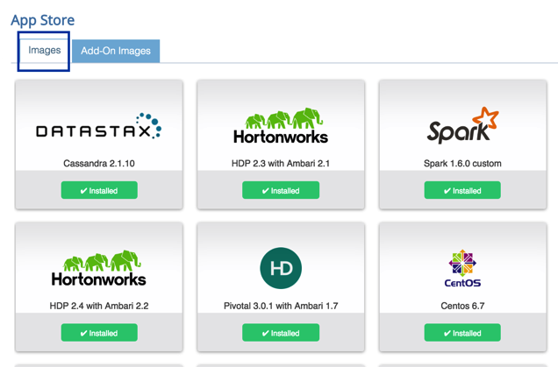
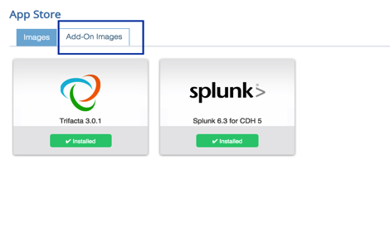
Categories Of Applications
There are 2 basic categories of applications
Distributions and base images
Hadoop/Spark distributions : Example CDH, HDP, MapR
Other big data & ML frameworks: Kafka, Cassandra, Tensorflow, IntelBigDL etc.,
Add on applications that work with Hadoop and Spark : Datameer, Trifacta, Splunk/Hunk created as edge nodes

Slide 9
Adding a new app to Bluedata
Login to Bluedata controller host Example: ssh <user>@<Host IP>
Download a bin file – Example: wget https://s3.amazonaws.com/bluedata-workbench/training/bdcatalog-centos-bluedata-rstudio136-3.0.bin
Copy bin to Bluedata local app repository – Example: cp bdcatalog-centos-bluedata-rstudio136-3.0.bin /srv/bluedata/catalog

Slide 10
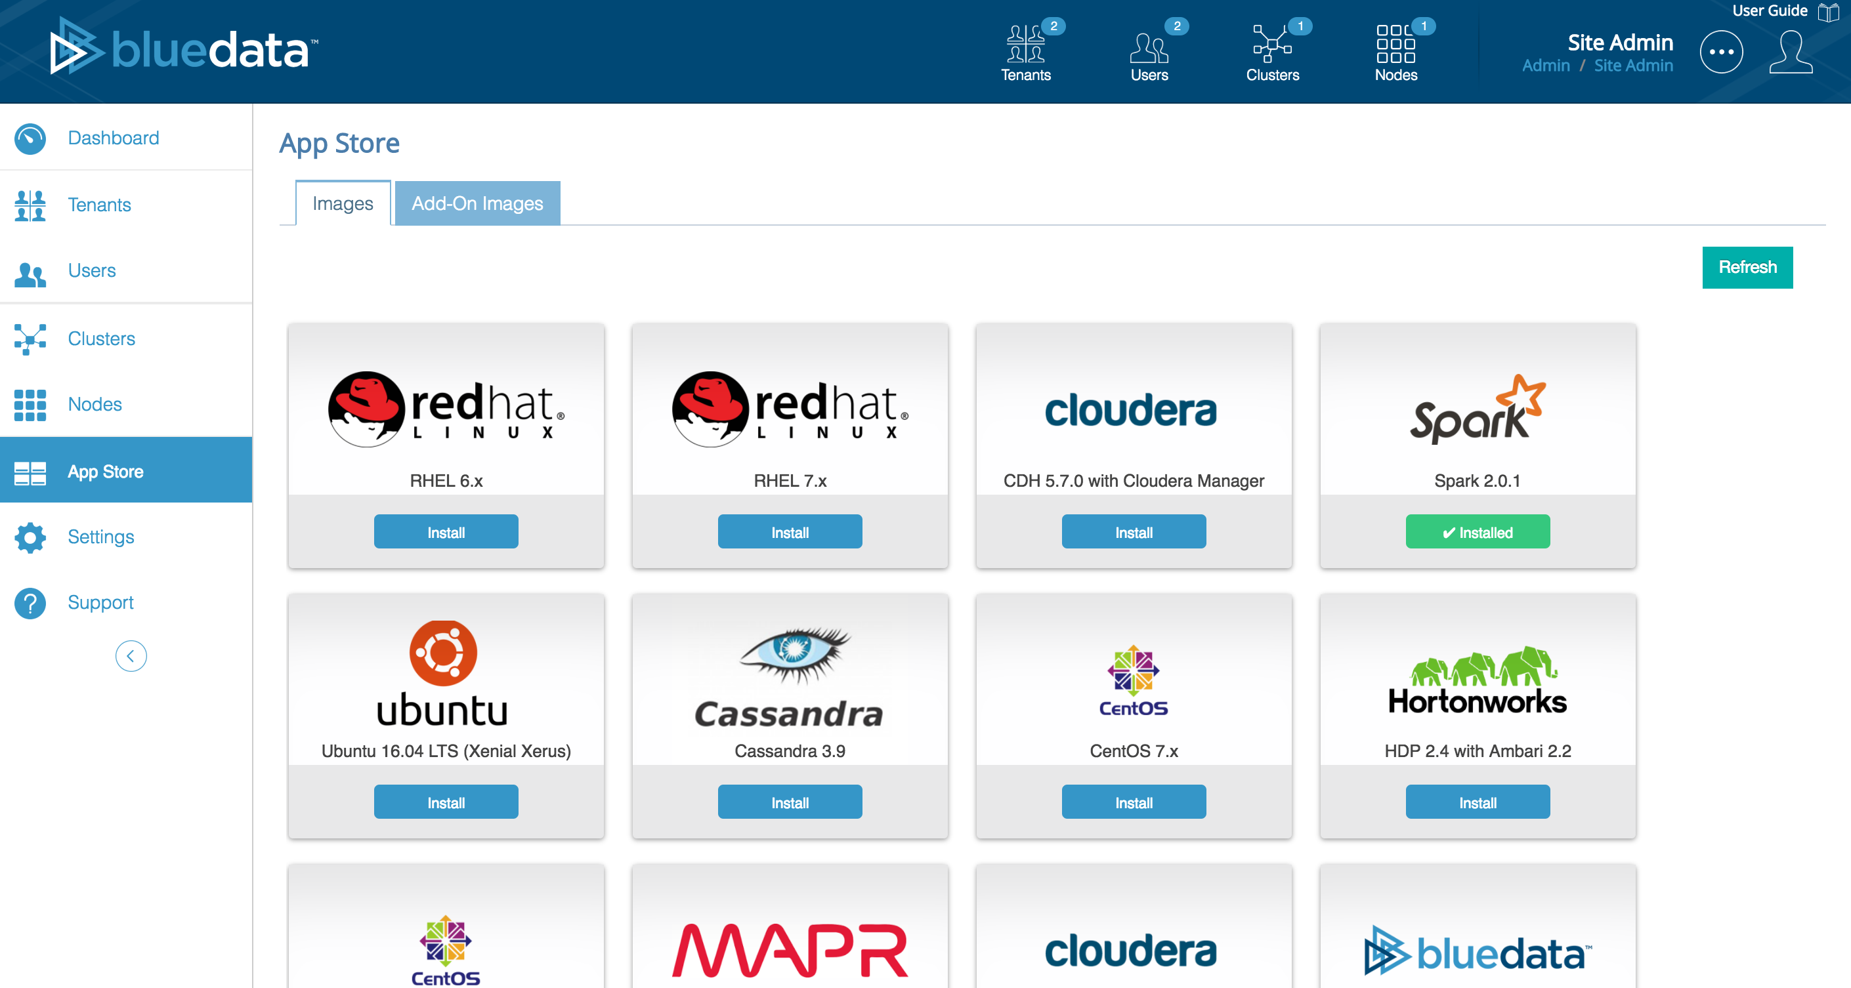
Enable application from UI
Bluedata -> Site Admin -> App Store -> Refresh
Click on Install

Slide 11
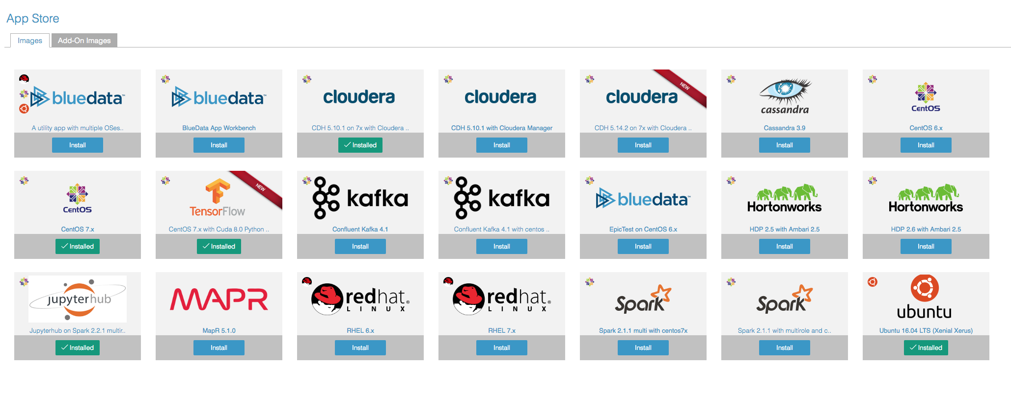
Epic 3.4 Appstore images

Slide 12
Auto extract and distribute .bin
Upon install, bin is extracted and contents are automatically copied to following locations on all physical hosts
Docker tgz file -- /opt/bluedata/catalog/bundles/install/<app dir>/<app-docker.tgz>
Application config -- /opt/bluedata/catalog/bundles/install/<app dir>/<app-config.tgz>
User interface metadata -- /opt/bluedata/catalog/bundles/install/<app dir>/<app-meta.json>

Slide 13
Explore bin files

Slide 14
BlueData App Image (.bin file)
Application bin file
appconfig
Docker image
<app> logo file
<app>.wb
bdwb command
Sources
CentOS
RHEL
Dockerfile
Dockerfile
conf
Init.d
startscript
clusterconfig, image, role, appconfig, catalog, service, ..
Docker file, logo .PNG, Init.d
OR
Development
(e.g. extract .bin and modify to create new bin)
Software Bits
Runtime

Slide 15
Extract existing image sources
wget https://s3.amazonaws.com/bluedata-workbench/training/bdcatalog-centos-bluedata-rstudio136-3.0.bin
chown apache:apache bdcatalog-centos-bluedata-rstudio136-3.0.bin
chmod +x bdcatalog-centos-bluedata-rstudio136-3.0.bin
./bdcatalog-centos-bluedata-rstudio136-3.0.bin --extract-sources
tar –xvzf bdcatalog-centos-bluedata-rstudio136-3.0-src.tgz
cd to src directory (bdcatalog-centos-bluedata-rstudio136-3.0-src)

Slide 16
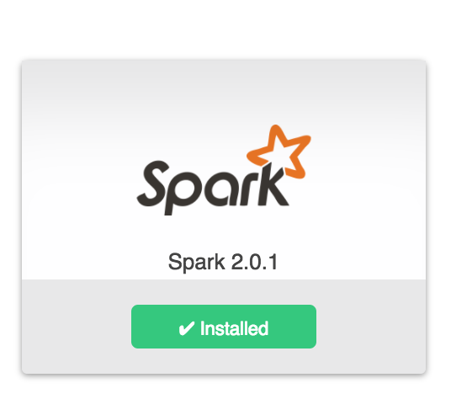
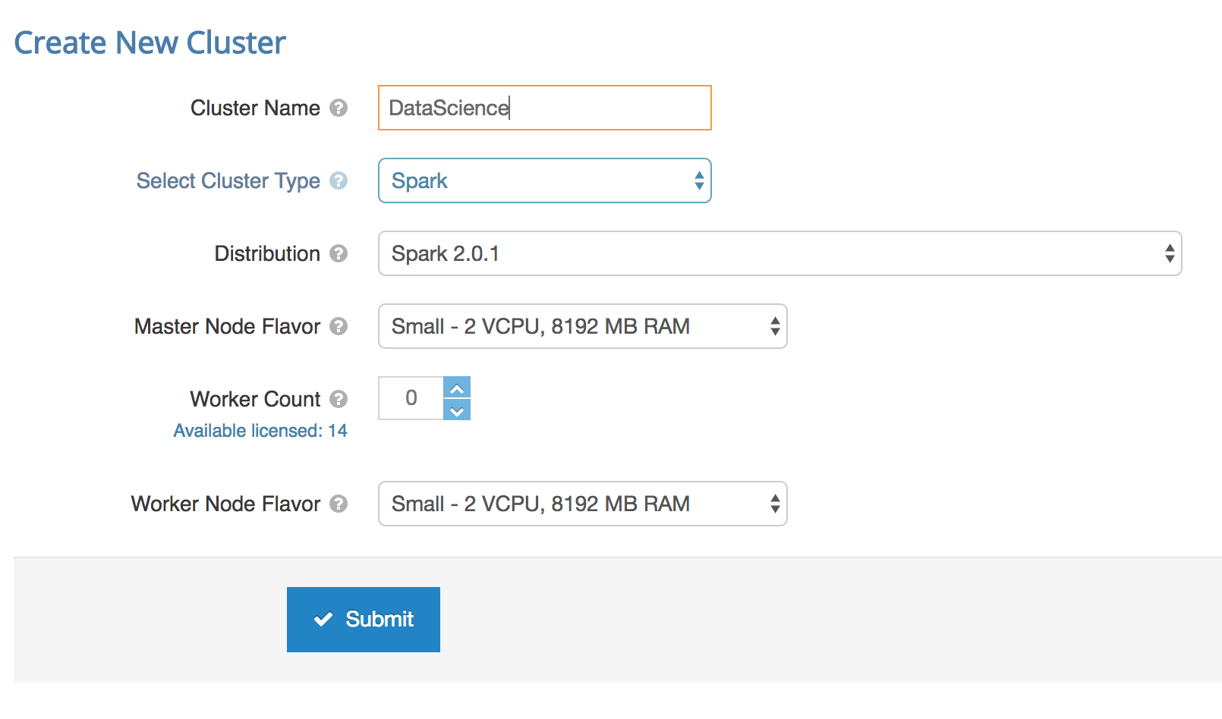
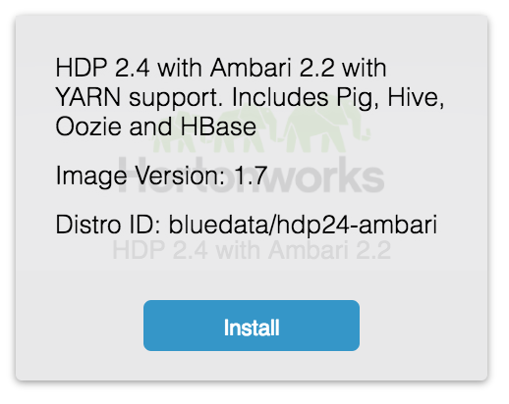
UI related metadata in bin file
App name
Description
Logo
Distro ID, version
Long Description
Cluster group name
Node flavor limits
Node count limits

Slide 17
Sample CentOS Dockerfile
# Spark-1. docker image for RHEL/CentOS 6.x
FROM bluedata/centos6:latest
# Download and extract spark
RUN mkdir /usr/lib/spark; curl -s http://archive.apache.org/dist/spark/spark-2.0.1/spark-2.0.1-bin-hadoop2.6.tgz | tar xz -C /usr/lib/spark/
## Install zeppelin
RUN mkdir /usr/lib/zeppelin; curl -s https://s3.amazonaws.com/bluedata-catalog/thirdparty/zeppelin/zeppelin-0.7.0-SNAPSHOT.tar.gz | tar xz -C /usr/lib/zeppelin
ADD configure_spark_services.sh /root/configure_spark_services.sh
RUN chmod -x /root/configure_spark_services.sh && /root/configure_spark_services.sh
Notes:
Changed Spark1.6 to Spark 2.0.1

Slide 18
Sample RHEL Dockerfile
# Spark-1. docker image for RHEL/CentOS 6.x
FROM bluedata/rhel6:latest
#Add RHEL subscription
RUN subscription-manager register –username=${RHEL_USERNAME} \
--password=${RHEL_PASSWORD} && subscription-manager attach –auto && \
subscription-manager repos –enable=rhel-6-server-optional-rpms && \
subscription-manager unsubscribe –all && subscription-manager unregister && subscription-manager clean
# Download and extract spark
RUN mkdir /usr/lib/spark; curl -s http://archive.apache.org/dist/spark/spark-2.0.1/spark-2.0.1-bin-hadoop2.6.tgz | tar xz -C /usr/lib/spark/
ADD configure_spark_services.sh /root/configure_spark_services.sh
RUN chmod -x /root/configure_spark_services.sh && /root/configure_spark_services.sh
Notes:
Changed Spark1.6 to Spark 2.0.1

Slide 19
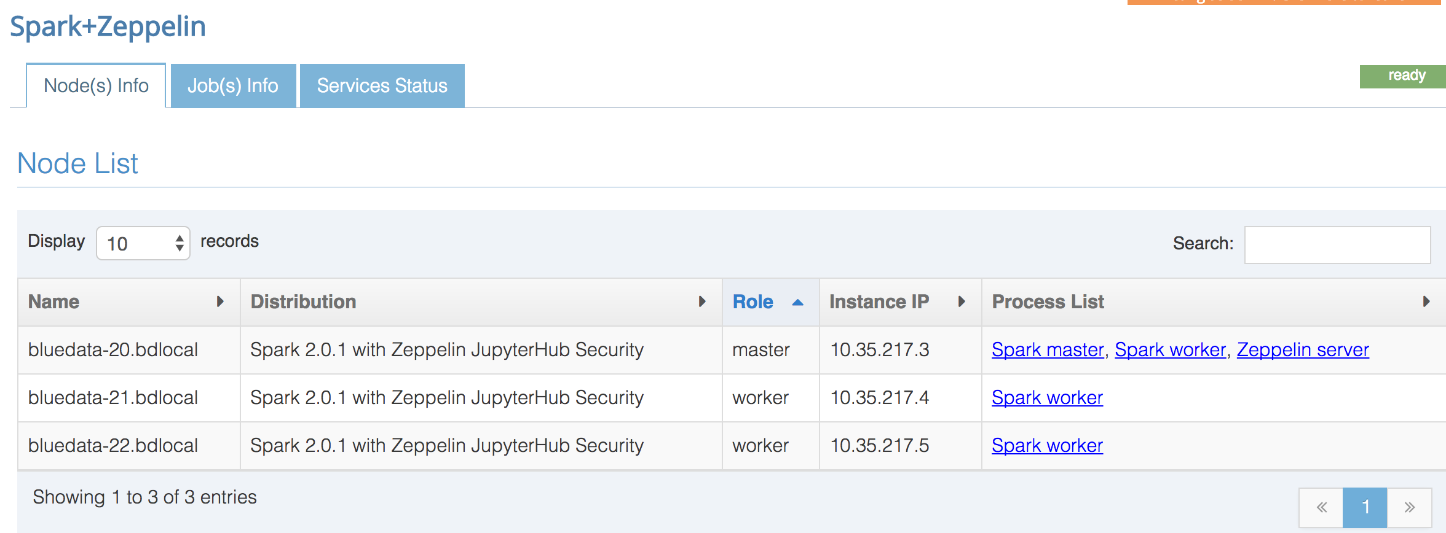
Roles and Services
Support for multiple roles in a cluster – Eg: master, worker, edge, gateway
List of supported services – Eg: Spark master, spark worker, Zeppelin server
Assign services to roles – Eg: Spark master runs on master master node

Slide 20
Templatized configurations - Appconfig
# Generic options for the daemons used in the standalone deploy mode
# - SPARK_CONF_DIR Alternate conf dir. (Default: ${SPARK_HOME}/conf)
# - SPARK_LOG_DIR Where log files are stored. (Default: ${SPARK_HOME}/logs)
# - SPARK_PID_DIR Where the pid file is stored. (Default: /tmp)
# - SPARK_IDENT_STRING A string representing this instance of spark. (Default: $USER)
# - SPARK_NICENESS The scheduling priority for daemons. (Default: 0)
SPARK_MASTER_HOST=@@@@MASTER_HOST@@@@
SPARK_WORKER_CORES=@@@@CORES@@@@
SPARK_WORKER_MEMORY=@@@@MEMORY@@@@
Notes:
Changed Spark1.6 to Spark 2.0.1

Slide 21
Runtime substitutions - Startscript
appconfig autogen --replace /usr/lib/spark/spark-2.0.1-bin-hadoop2.6/conf/spark-defaults.conf \
--pattern @@@@SPARK_MASTER@@@@ --macro GET_SERVICE_URL spark_master controller
appconfig autogen --replace /usr/lib/spark/spark-2.0.1-bin-hadoop2.6/conf/spark-env.sh \
--pattern @@@@MASTER_HOST@@@@ --macro GET_FQDN_LIST controller
appconfig autogen --replace /usr/lib/spark/spark-2.0.1-bin-hadoop2.6/conf/spark-env.sh \
--pattern @@@@MEMORY@@@@ --macro echo "$(GET_TOTAL_VMEMORY_MB)m"
appconfig autogen --replace /usr/lib/spark/spark-2.0.1-bin-hadoop2.6/conf/spark-env.sh \
--pattern @@@@CORES@@@@ --macro GET_TOTAL_VCORES
Notes:
Changed Spark1.6 to Spark 2.0.1

Slide 22
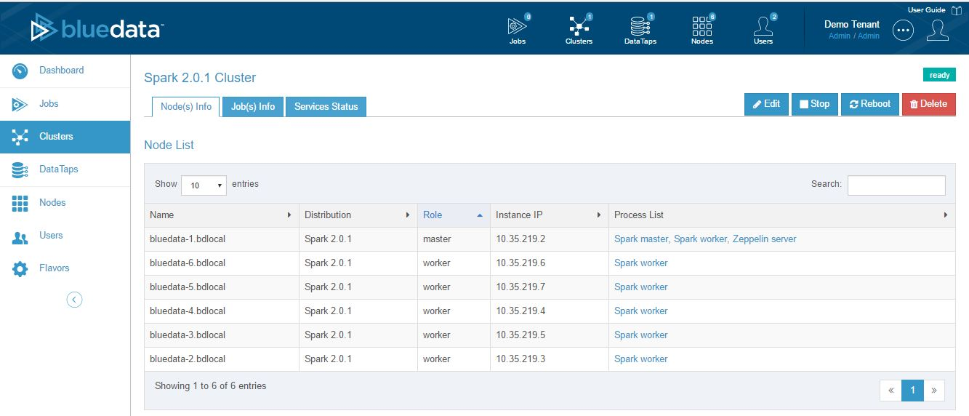
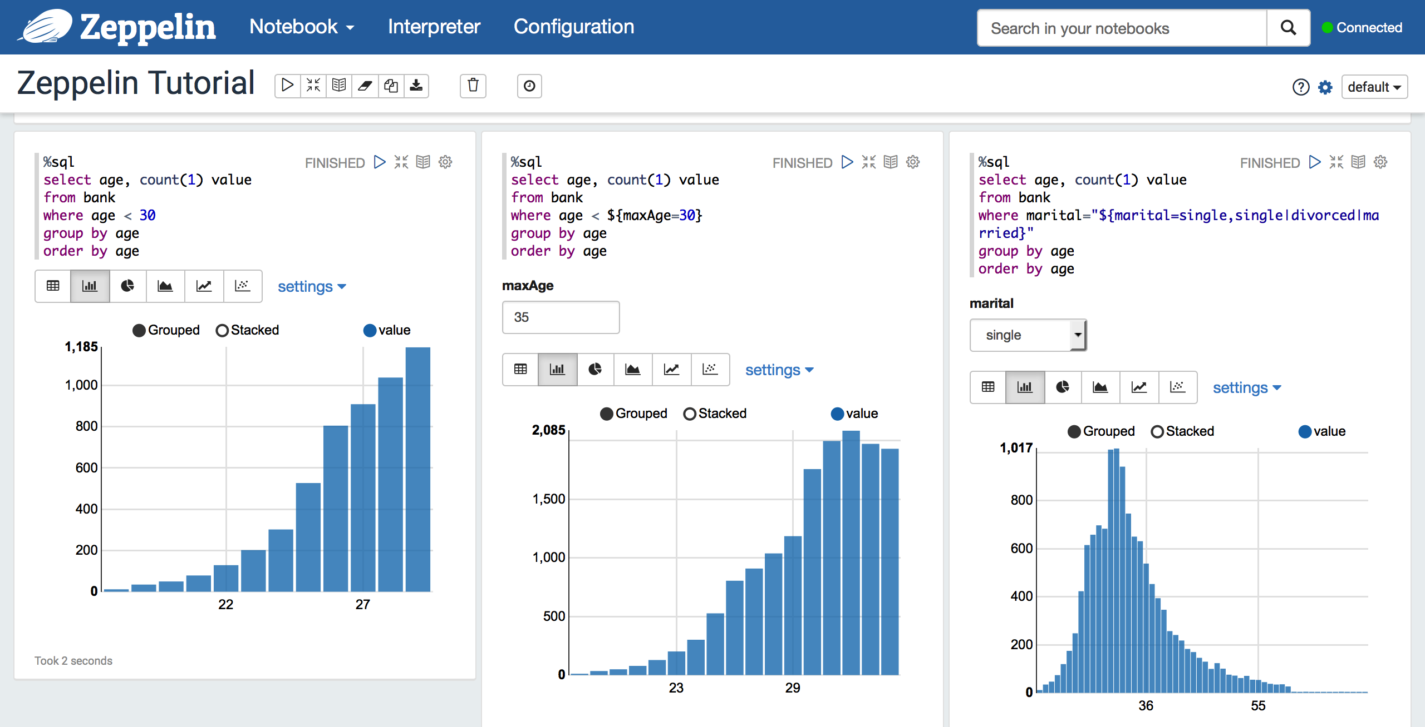
Running Docker containers
Spark with Zeppelin Notebook
5 fully managed Docker containers with persistent IP addresses

Slide 23
Bluedata Image details
Bluedata image bin file has 4 key component
Image Directory – Dockerfile can be found under image/centos or image/rhel
Appconfig Directory – All config scripts and start scripts are provided under appconfig folder
Logo file – Logo that gets displayed on Appstore
.wb file – A workbench file that builds/assembles all the core components into a bin file

Slide 24
In scope and out of scope criteria
Applications must support the following criteria to be productized as an image in BlueData App Store
Must run on Centos 6.x/7.x or equivalent RHEL
Must have a Web UI or an API support for client interaction
Application must support unattended install and configuration

Slide 25
BDWB Shell

Slide 26
Exercise : bin file management with “bdwb”
BlueData provides an SDK and a CLI tool called “bdwb”
“bdwb” has commands for adding/modifying
Images using Docker files: bdwb> help image
Role management in a multi-node, multi-service deployment: bdwb> help role
Creating new catalog and modifying existing catalog entries:
bdwb> help catalog
Adding Conf files and init.d scripts to package: bdwb> help appconfig
Extended inline help is also available for bdwb
bdwb> help appconfig autogen

Slide 27
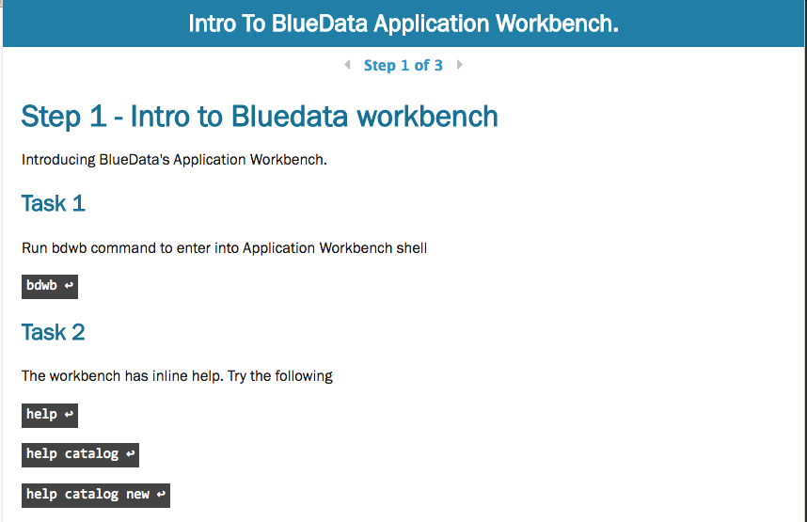
Exercise : bin file management with “bdwb”

Slide 28
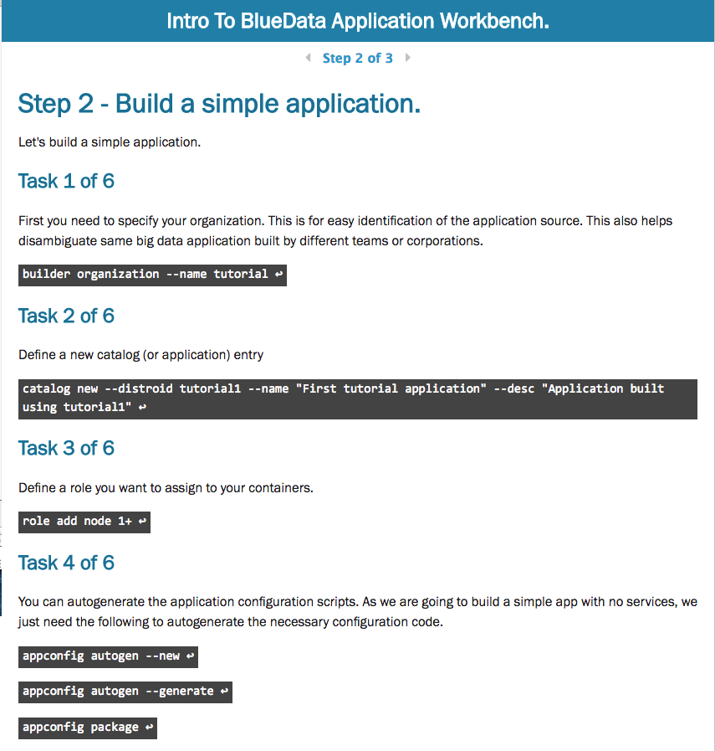
Exercise : bin file management with “bdwb”

Slide 29
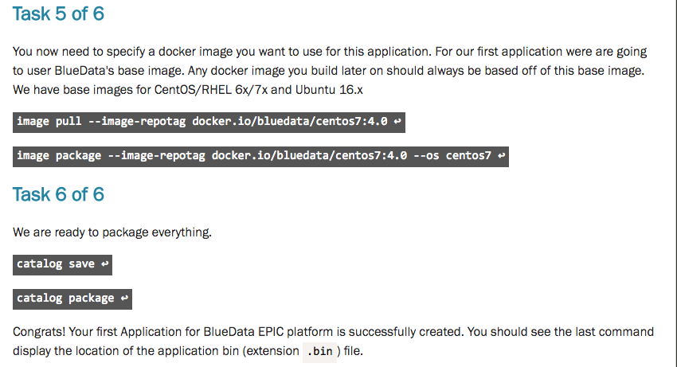
Exercise : bin file management with “bdwb”

Slide 30
Documentation
bdwb shell document & lab exercises
https://github.com/bluedatainc/solutions/blob/master/bdvcli_commands/Lab-exercise_%20Introducing%20BlueData's%20Application%20Workbench.pdf
https://github.com/bluedatainc/solutions/tree/master/bdvcli_commands

Slide 31
Application workbench use cases
1. Create a basic bluedata app image. (ex:Spark221)
2. Create a multi-role image (ex: Spark221 multi image)
3. Modify or upgrade an existing CDH image

Slide 32
Examples

Slide 33
Basic Spark Image building

Slide 34
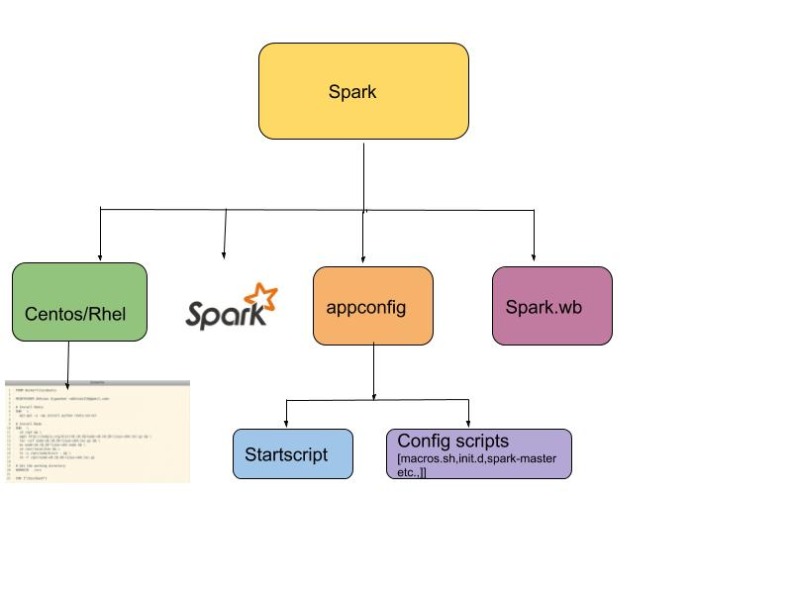
Building a basic Spark 2.2 image

Slide 35
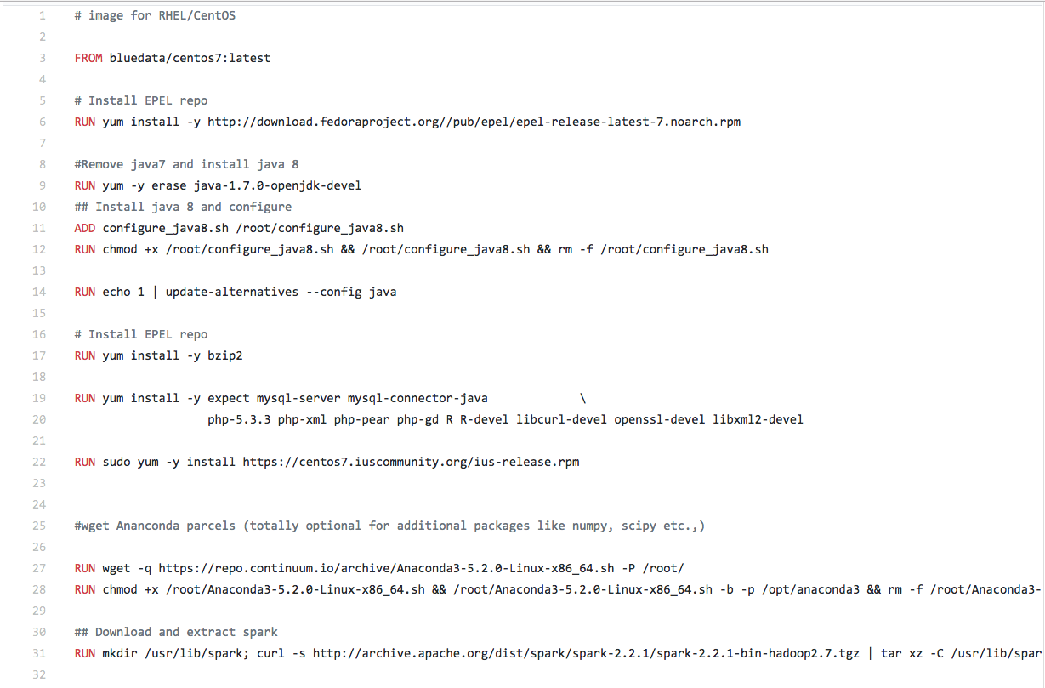
Spark 2.2 image- Dockerfile
Notes:
This Dockerfile has only Spark application bits. I have also added Anaconda bits but it’s totally optional.

Slide 36
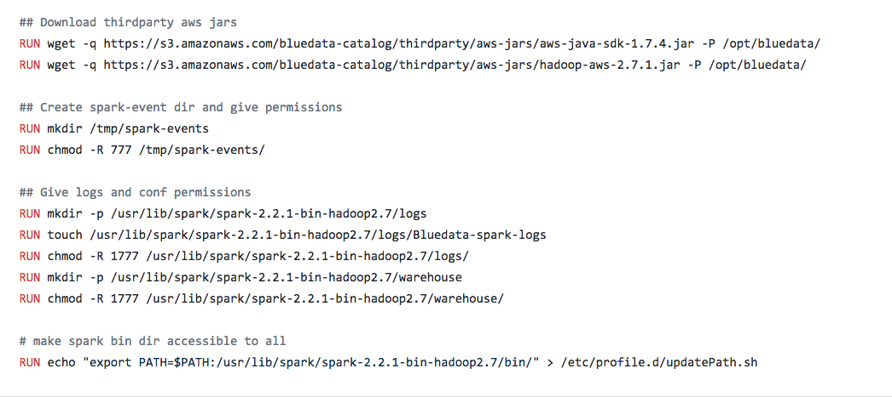
Spark 2.2 image- Dockerfile

Slide 37
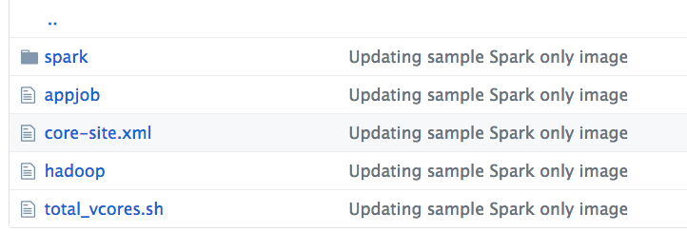
Spark 2.2 image- Appconfig
These are the application configuration scripts for spark.

Slide 38
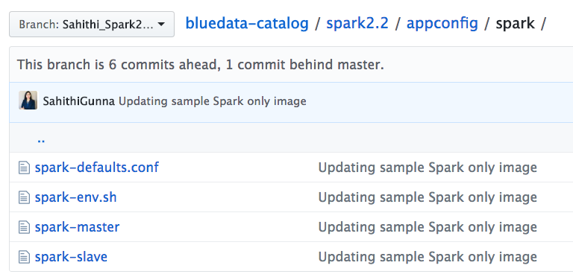
Spark 2.2 image- Appconfig > Spark
These are the spark init.d scripts & conf files

Slide 39
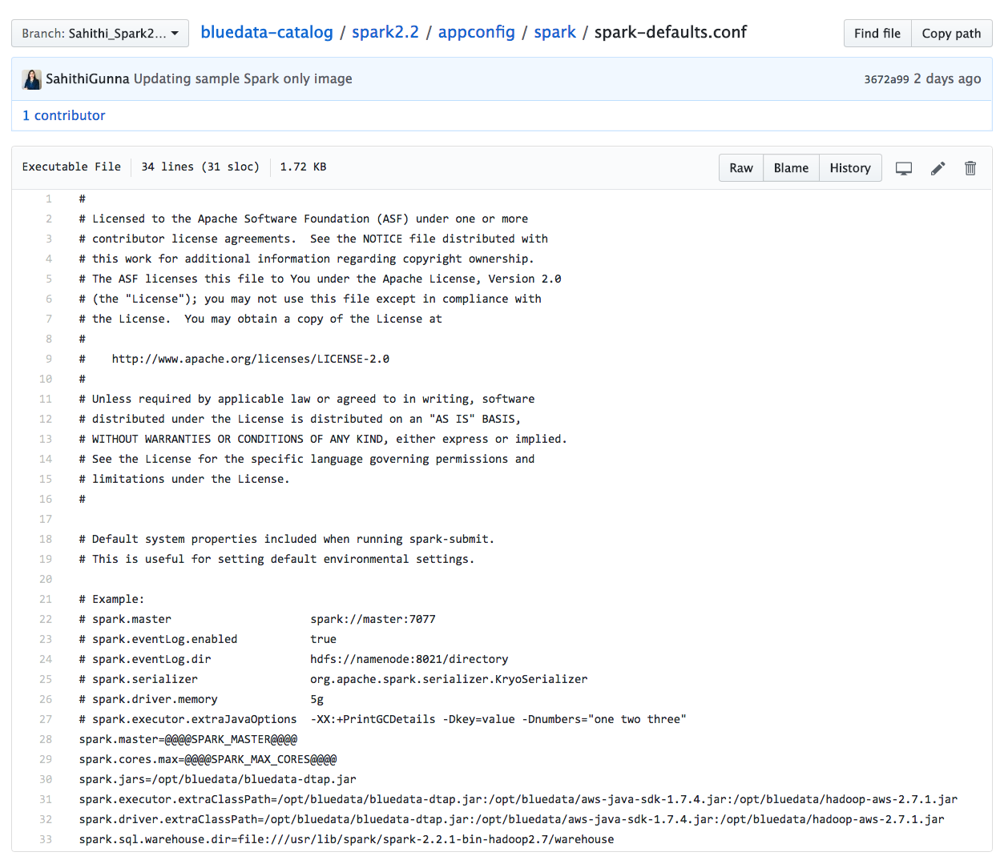
Spark 2.2 image- Appconfig > Spark
spark-defaults.conf:

Slide 40
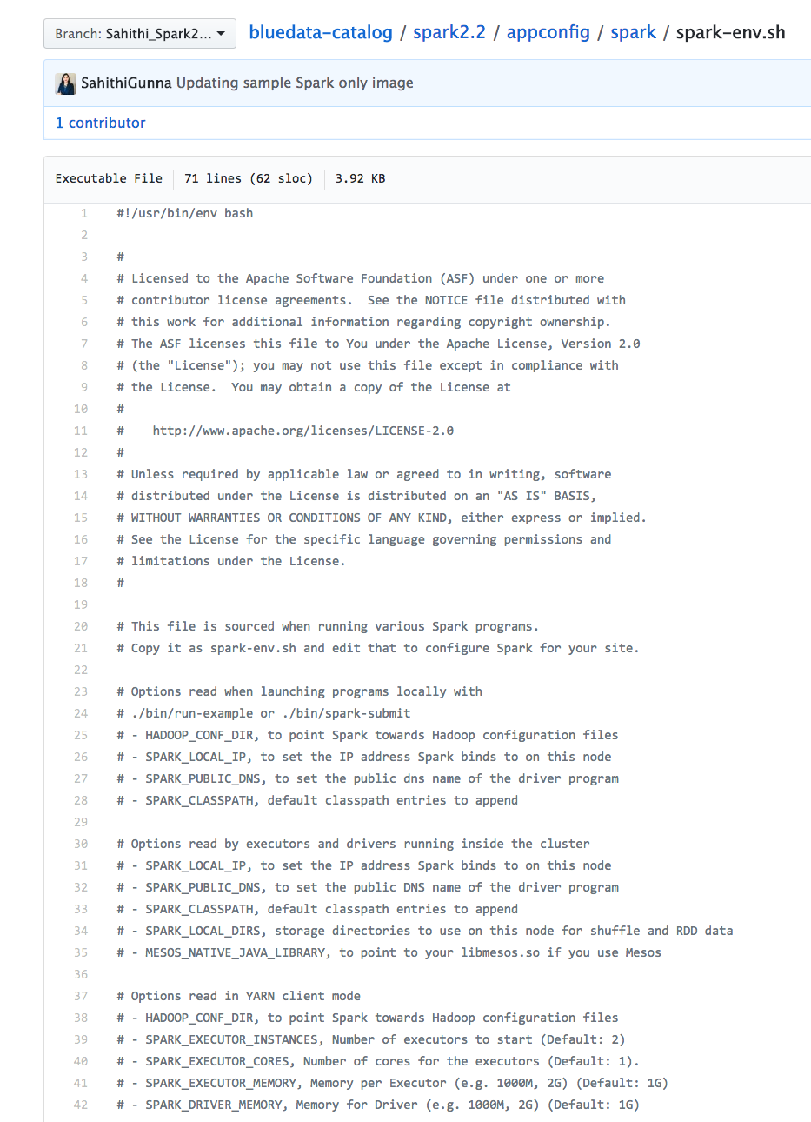
Spark 2.2 image- Appconfig > Spark
spark-env.sh:

Slide 41
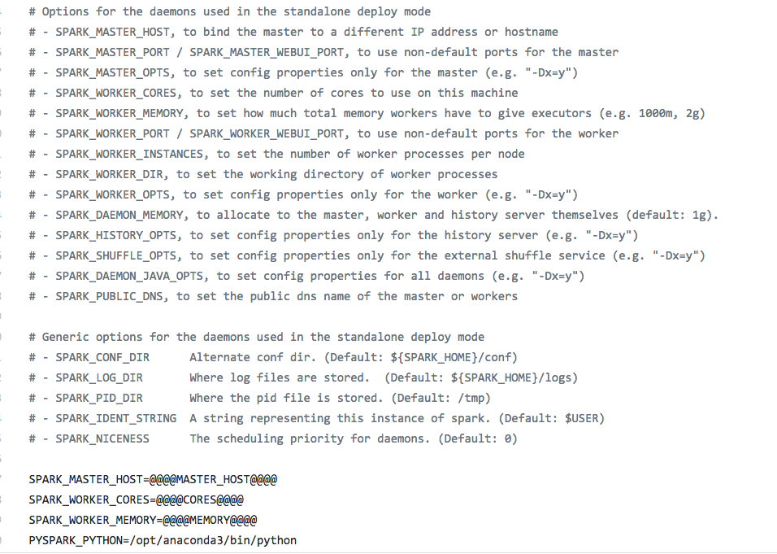
Spark 2.2 image- Appconfig > Spark
spark-env.sh (cont..):

Slide 42
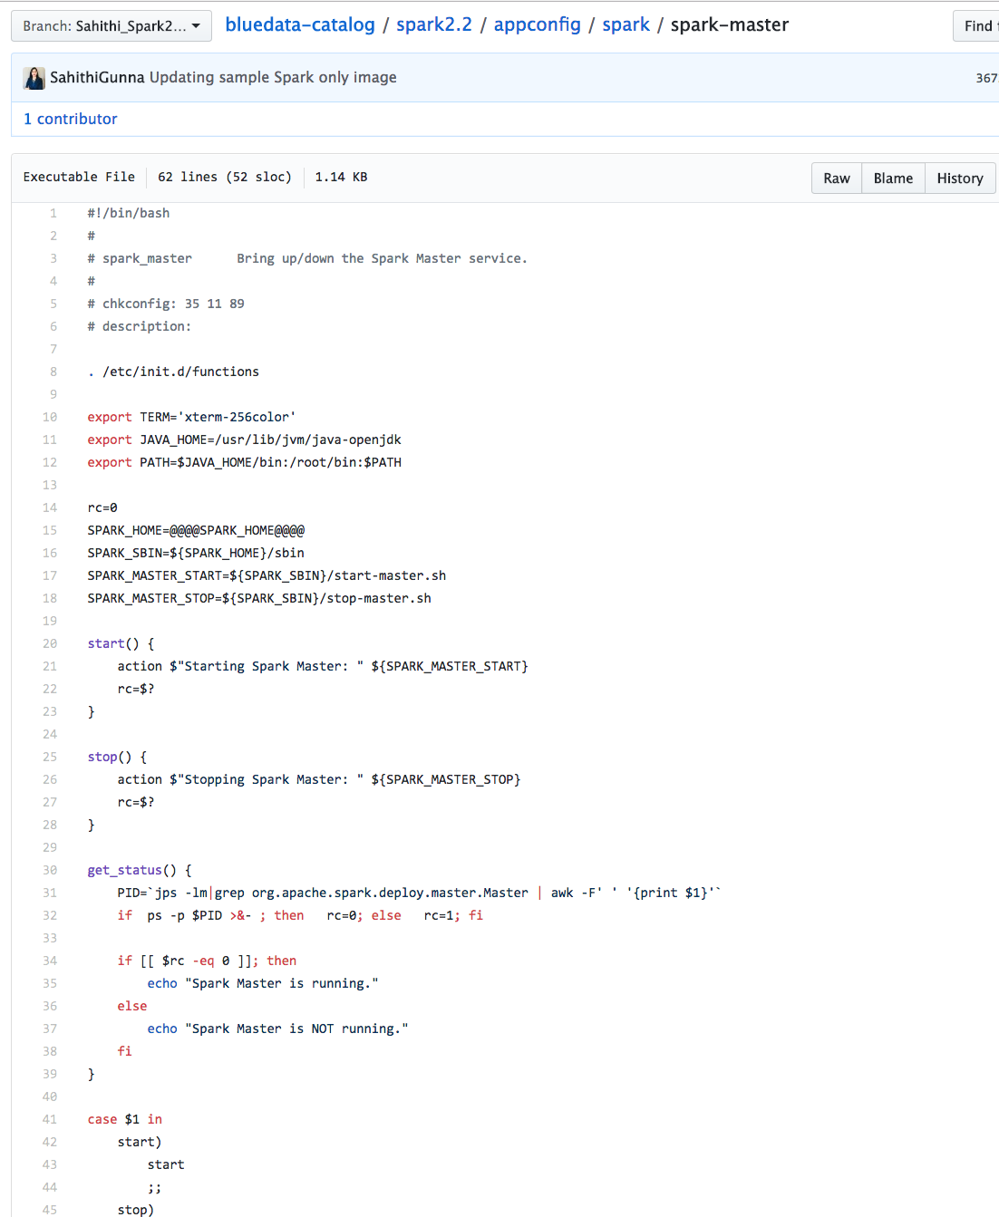
Spark 2.2 image- Appconfig > Spark
spark-master:

Slide 43
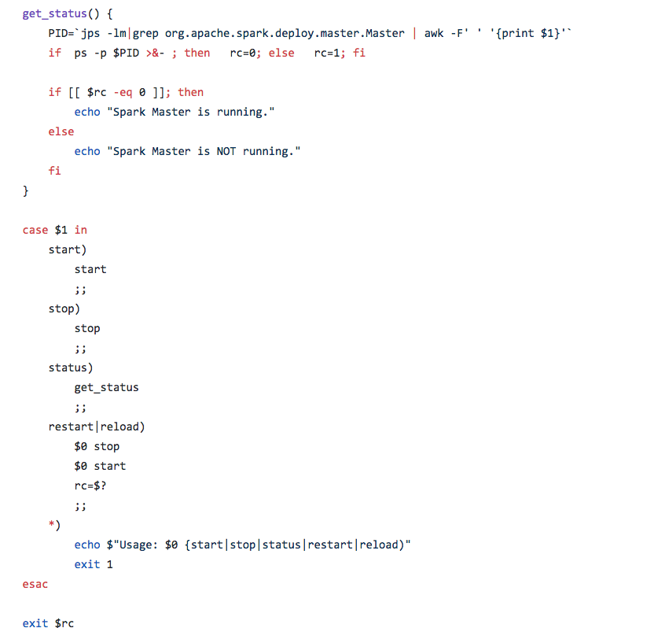
Spark 2.2 image- Appconfig > Spark
spark-master (cont..):

Slide 44
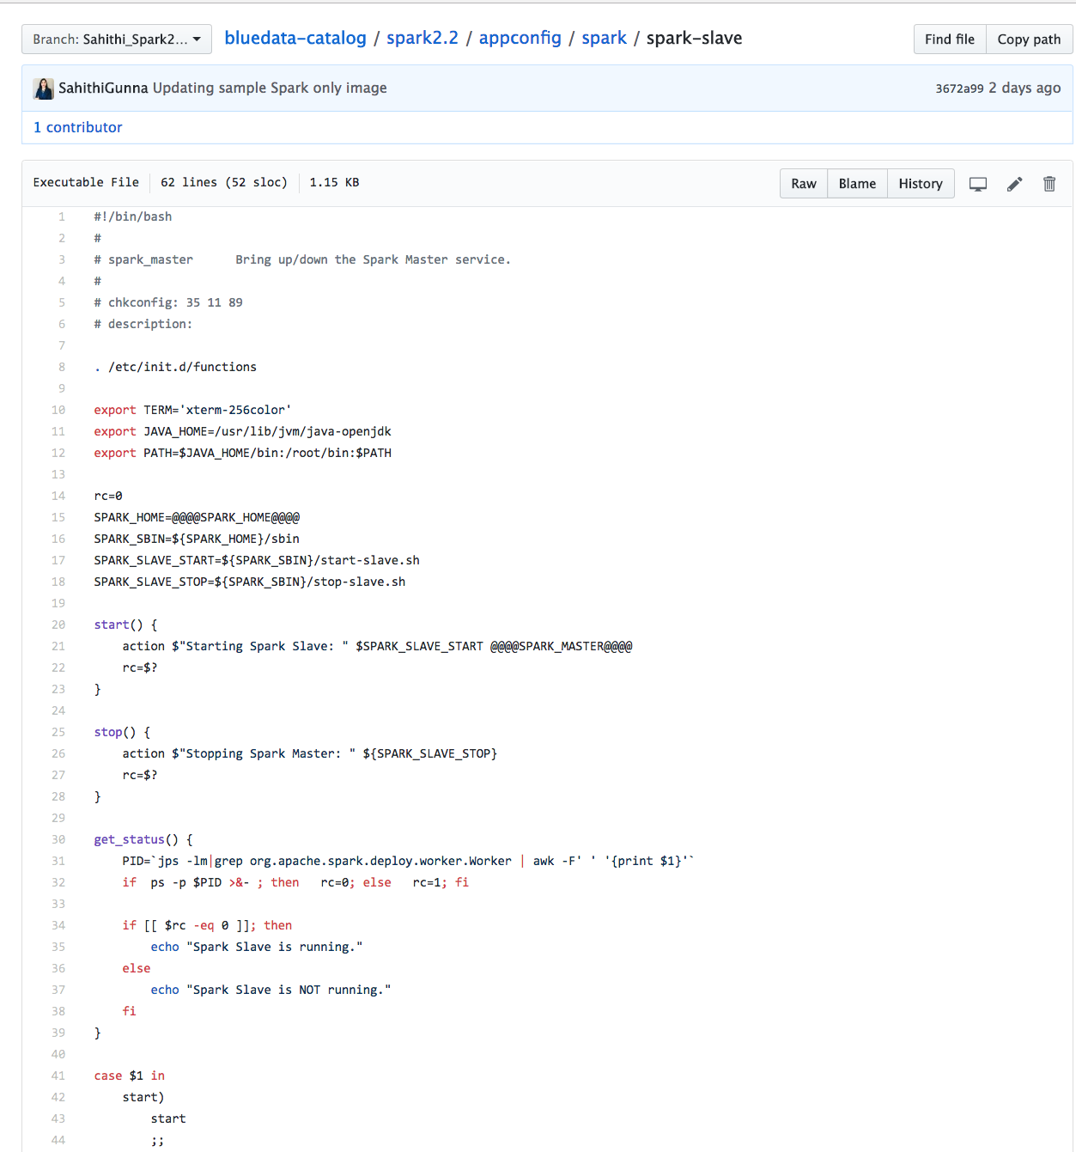
Spark 2.2 image- Appconfig > Spark
spark-slave:

Slide 45
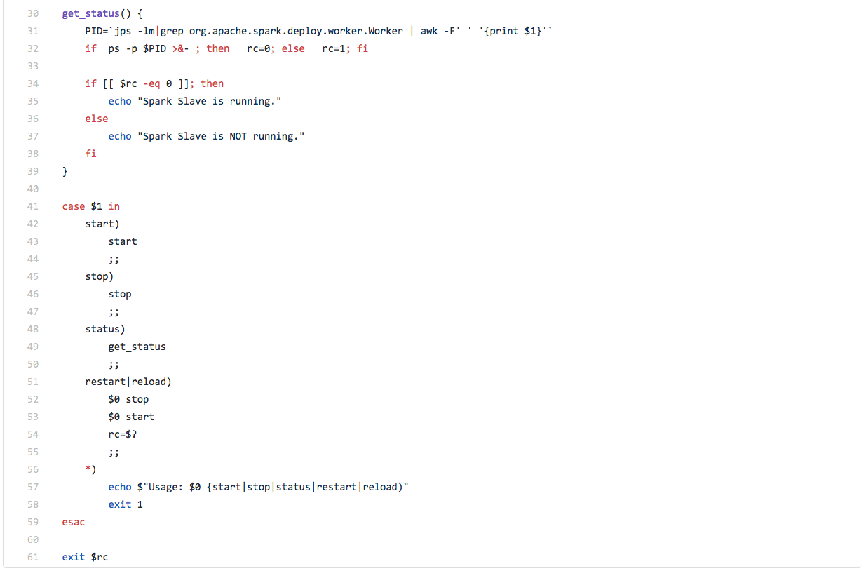
Spark 2.2 image- Appconfig > Spark
spark-slave (cont..):

Slide 46
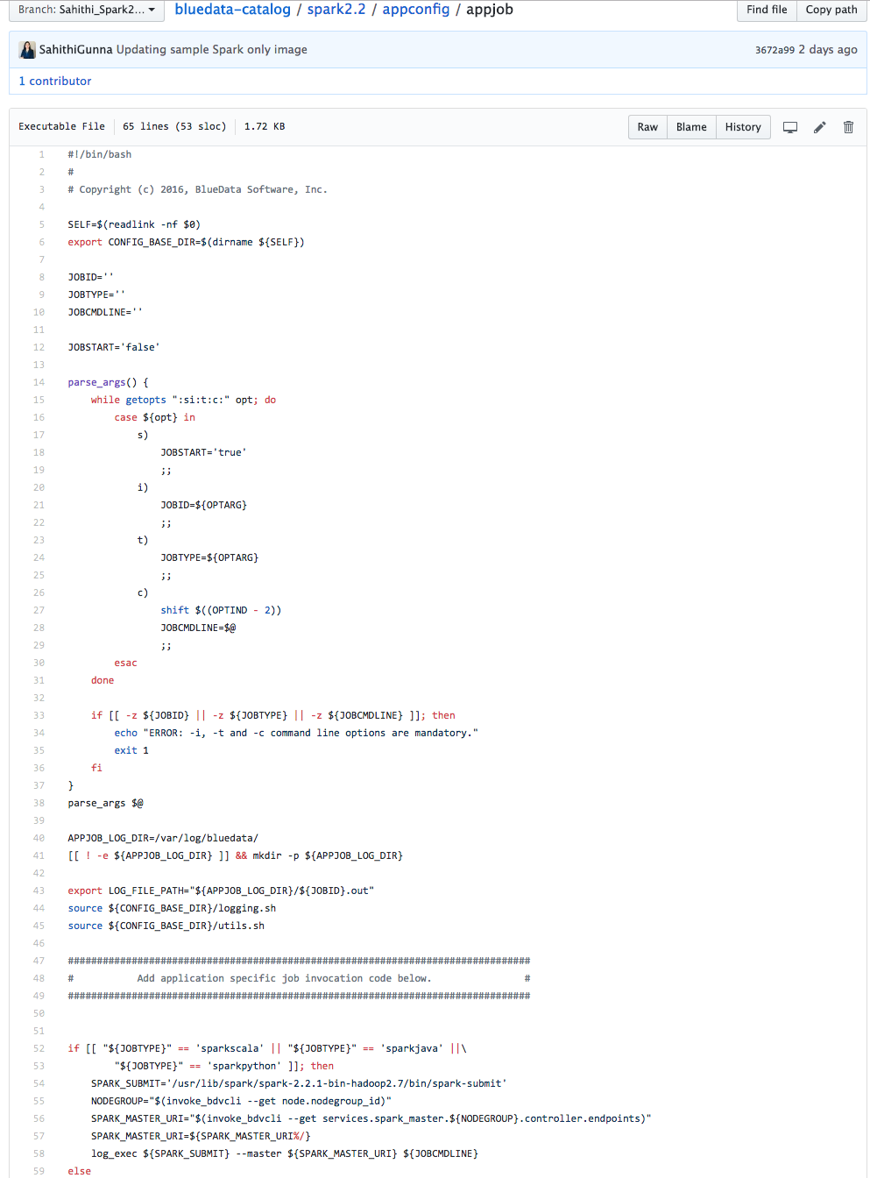
Spark 2.2 image- Appconfig
appjob:

Slide 47
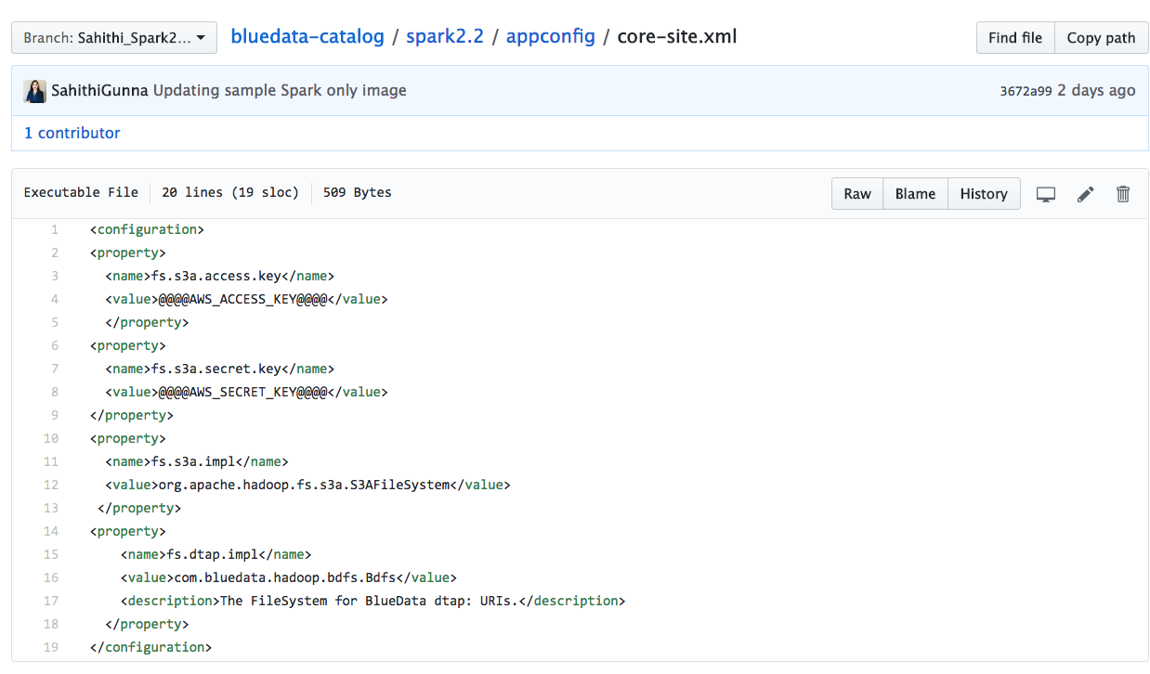
Spark 2.2 image- Appconfig
core-site.xml:

Slide 48
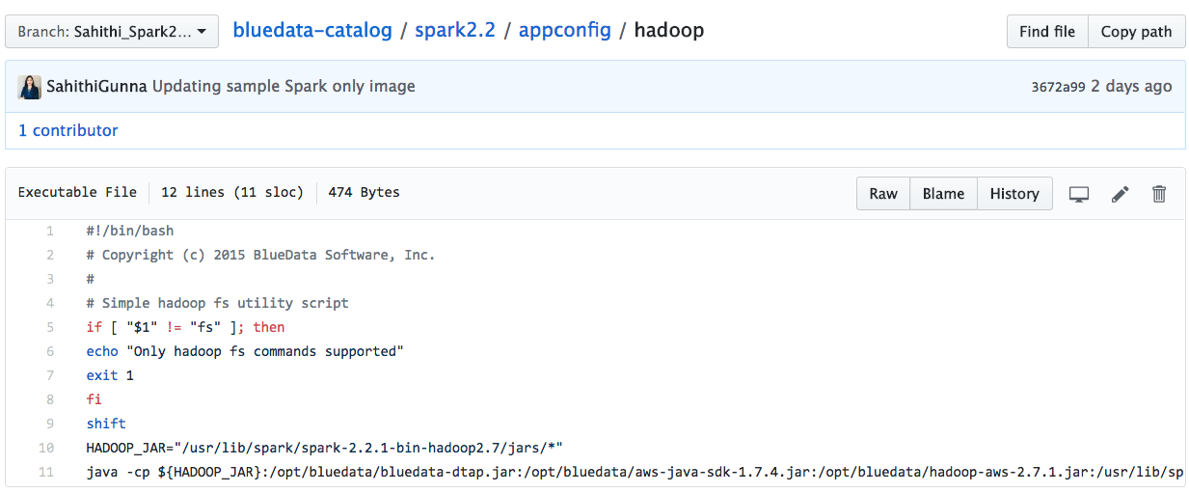
Spark 2.2 image- Appconfig > Spark
hadoop:

Slide 49
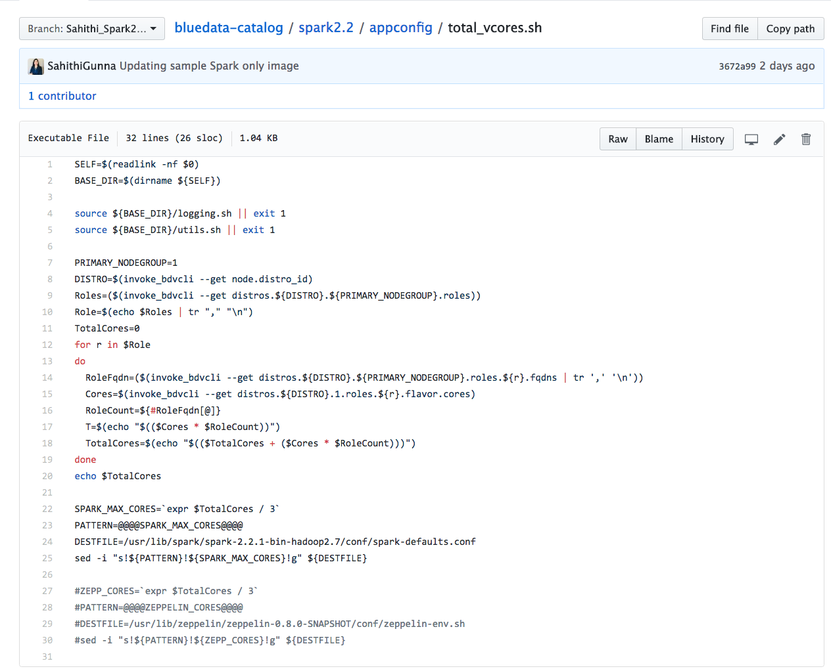
Spark 2.2 image- Appconfig
total_vcores.sh:

Slide 50
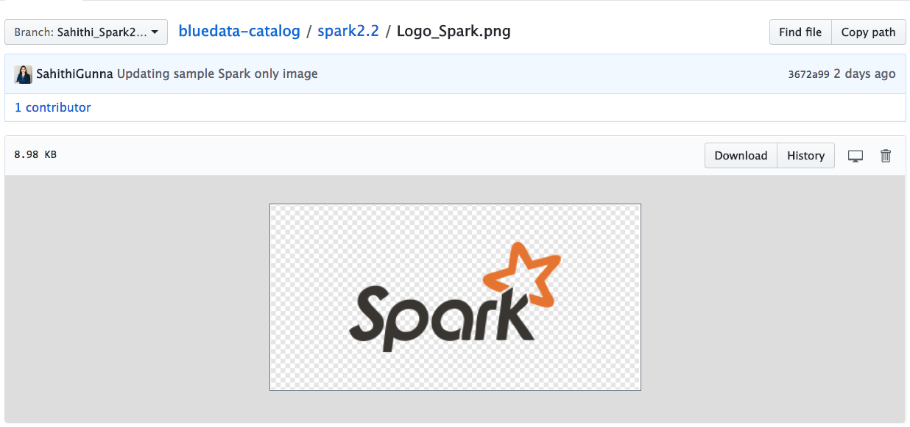
Spark 2.2 image-Logo_Spark.png

Slide 51
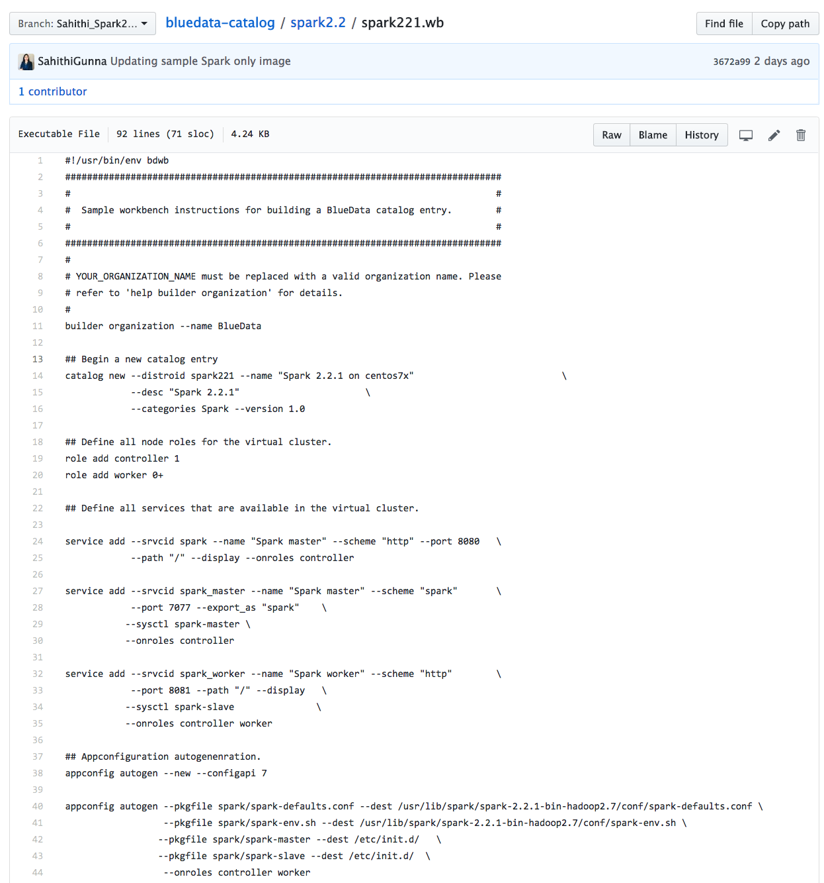
Spark 2.2 image-WB file

Slide 52
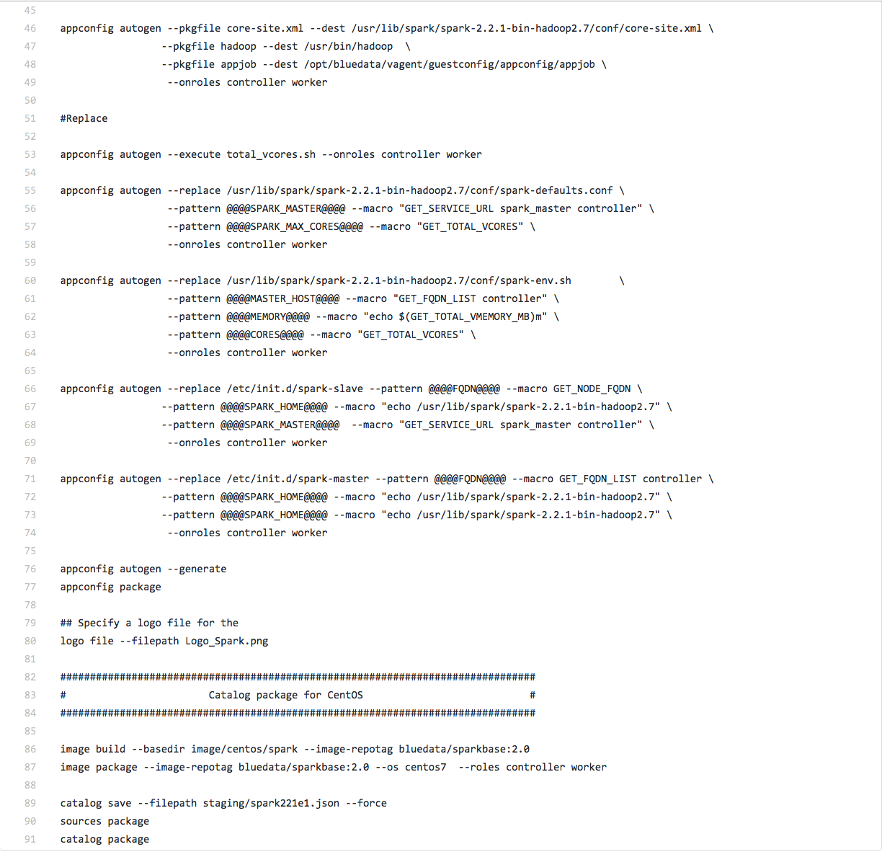
Spark 2.2 image-WB file (cont..)

Slide 53
Source files for Lab exercises
Basic Spark code:
https://s3.amazonaws.com/bluedata-catalog/solutions/training/Spark221_singleimg_official.tgz
CDH5.10.1 image code:
https://s3.amazonaws.com/bluedata-catalog/solutions/training/CDH-5.10.1-official.tgz
CDH5.14.2 image upgrade:
https://s3.amazonaws.com/bluedata-catalog/solutions/training/cdh5142-official.tgz
Multirole image code details:
https://s3.amazonaws.com/bluedata-catalog/solutions/training/Multirole-image.tgz

Slide 54
Spark Multi-role Image building

Slide 55
What is Multi-role?
Adding new multiple roles or custom roles to the existing image.
Multirole provides an ability to define a specific role & map services per role basis.
Let’s take an example of Spark with multiple notebooks image.
This image has the following services or the apps.
Spark,
Jupyter-notebook,
Jupyterhub,
Zeppelin and
Spark-edge node.

Slide 56
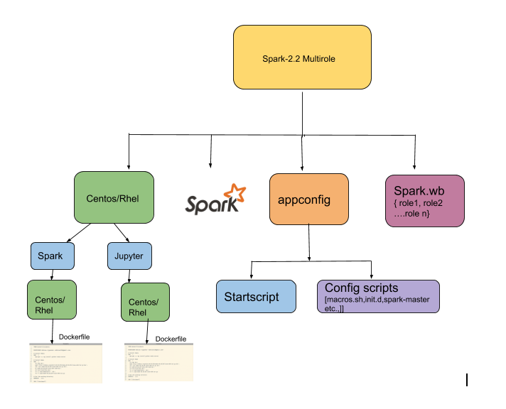
Multi-role concepts:

Slide 57
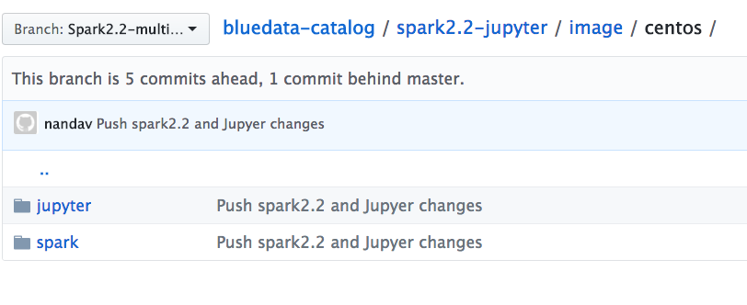
Spark221 multirole Image - Dockerfile

Slide 58
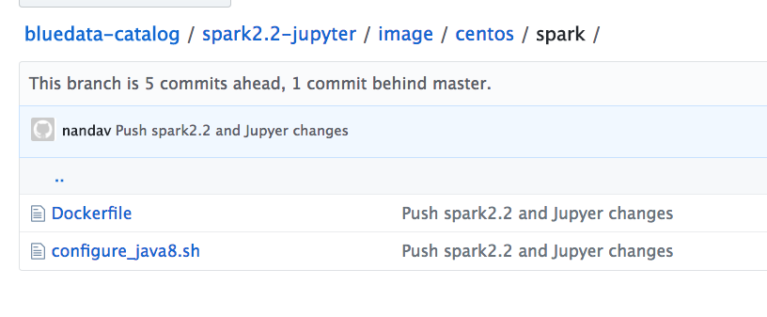
Spark221 multirole Image - Dockerfile

Slide 59
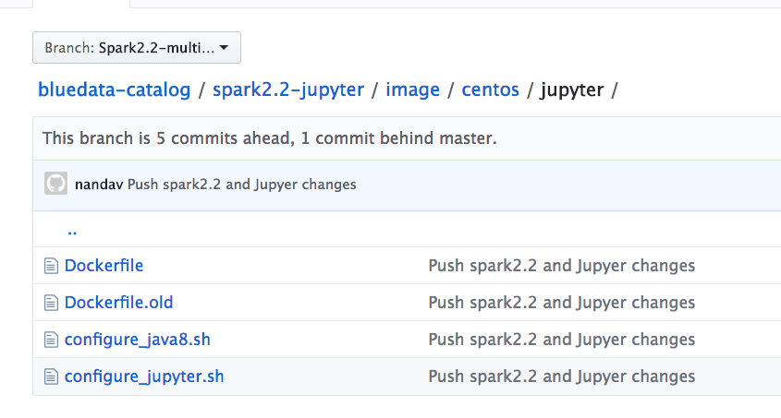
Spark221 multirole Image – Dockerfile

Slide 60
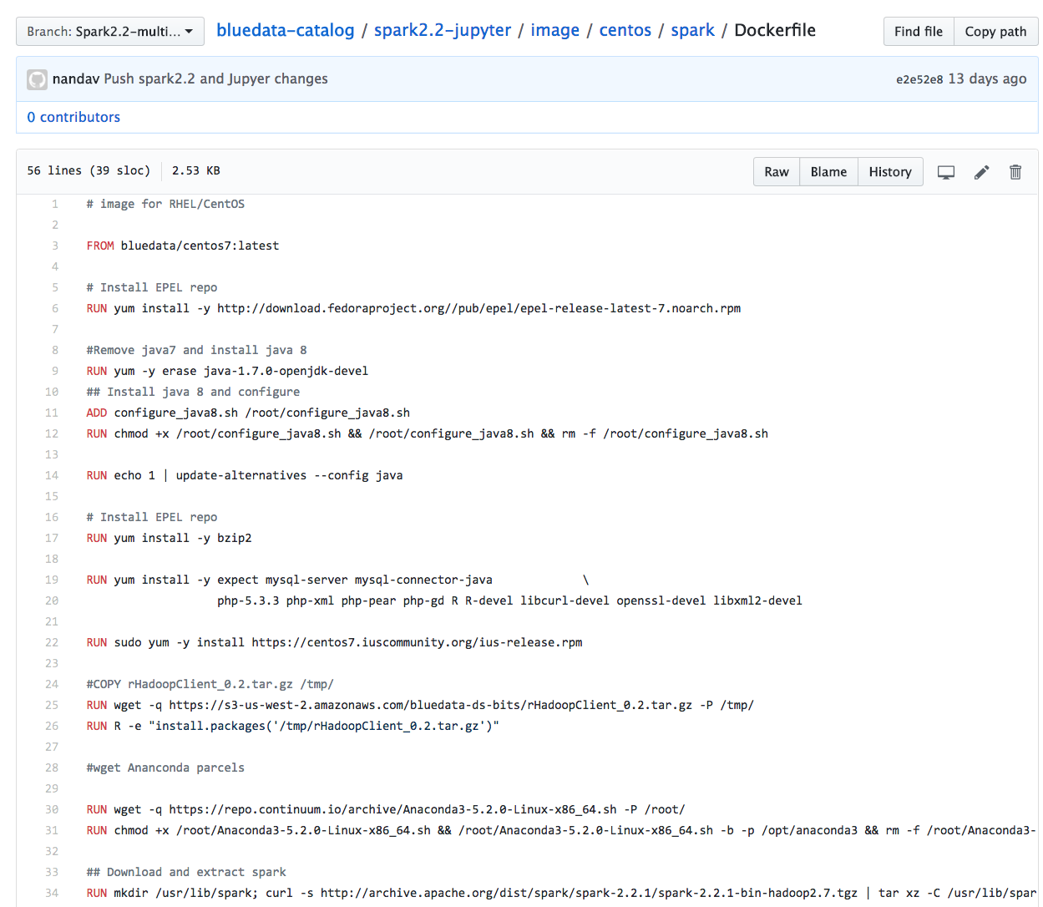
Spark221 multirole Image – Spark Dockerfile
Let’s look at the dockerfile:

Slide 61
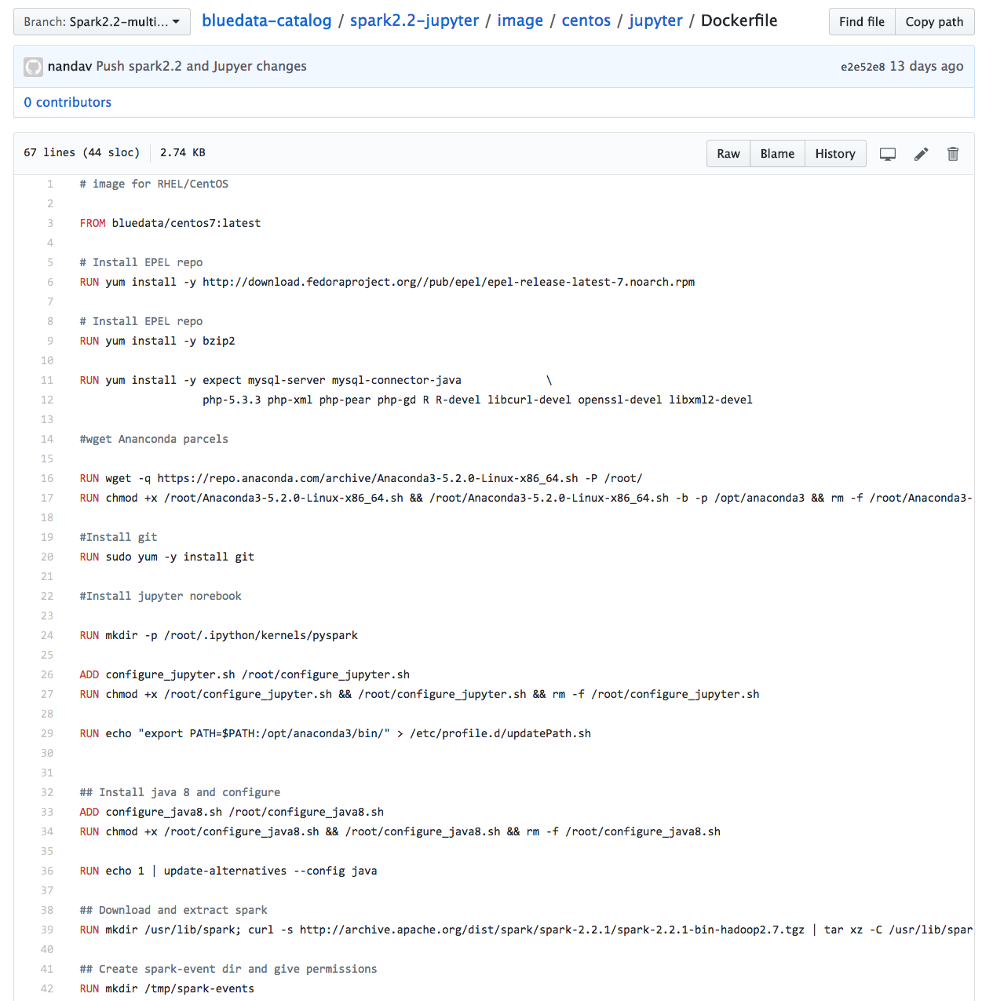
Spark multirole Image- Jupyter Dockerfile

Slide 62
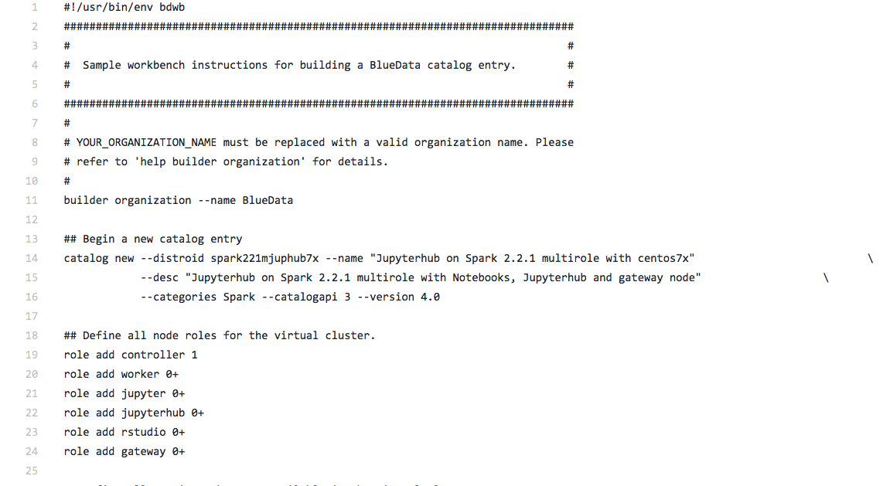
Spark multirole Image –WB file
Adding multiple roles

Slide 63
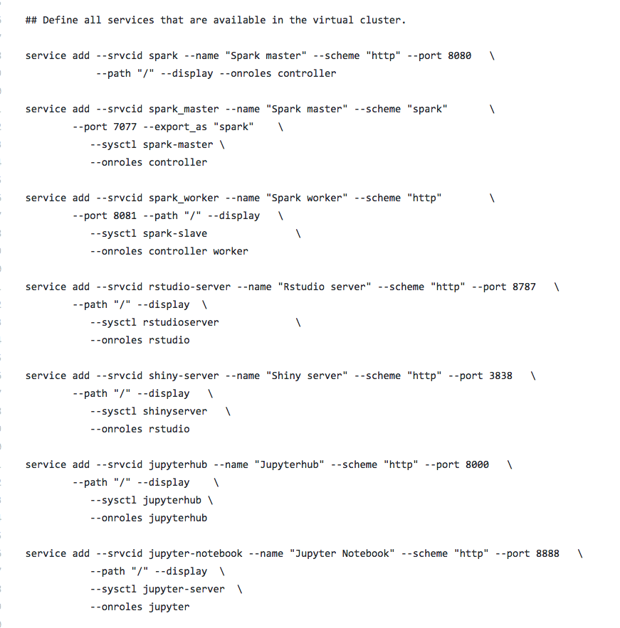
Spark multirole Image –WB file(cont..)
Mapping services per role

Slide 64
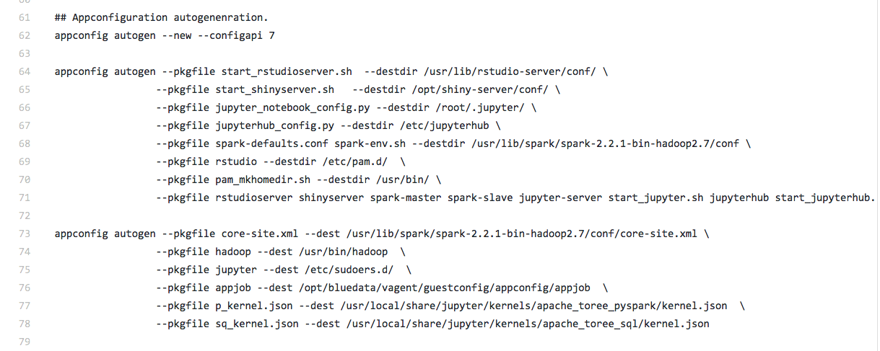
Spark multirole Image –WB file(cont..)

Slide 65
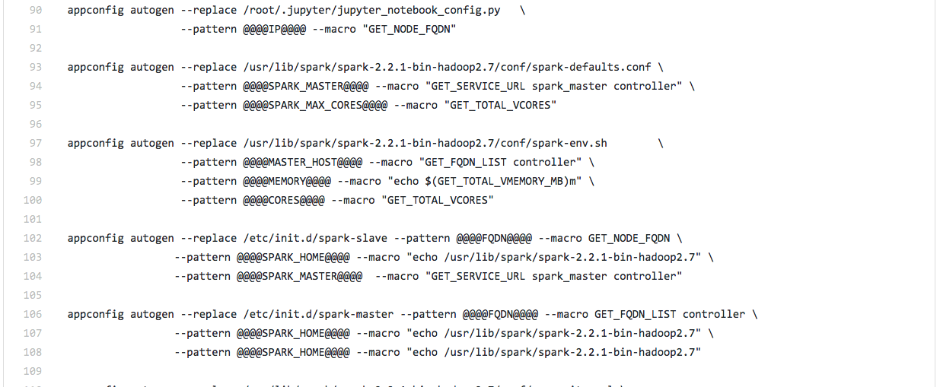
Spark multirole Image –WB file(cont..)

Slide 66
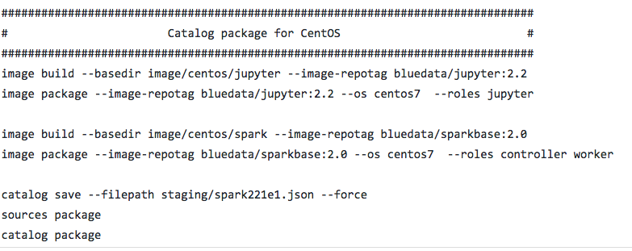
Spark multirole Image –WB file(cont..)
Installs docker image on to the role “Jupyter”
Installs docker image on role “controller”, “worker”

Slide 67
Adding custom scripts to wb
Users can add their own custom scripts to update configuration parameters during deployment
appconfig autogen --execute total_vcores.sh
Note: Those scripts can be placed under appconfig directory and used by simply providing the name

Slide 68


Slide 69
Agenda – Day 2
Topics | Content | Owner | Time
CDH Image Building | Upgrade CDH image to different version | Nanda/Sahithi | 9:00 am – 10:15 am
Break |  |  | 10:15 am – 10:30 am
CDH Image Building | Add new service or dependency to the existing image Lab exercise on CDH image upgrade | Nanda/Sahithi | 10:30 am – 12:30 pm
Lunch |  |  | 12:30 pm – 1:30 pm
ActionScripts | Introduction to ActionScript Lab for ActionScript | Nanda/Sahithi | 1:30pm – 2:30pm
Break |  |  | 2:30pm – 2:45pm
DTAP integration with 3rd-party apps | Introduction to third party apps DTAP integration | Nanda/Sahithi | 2:45pm – 4:00pm
Q&A | Open Q&A session |  | 4:00 pm – 5:00pm
Wrap-Up | Review of content covered Final Q&A |  | 4:45pm - 5:00pm

Slide 70
Upgrade CDH image

Slide 71
Common Use Case 1: Upgrade CDH Image
Update CDH 5.8.3 to CDH 5.14.2
Unpack the package for CDH 5.8.3
Update the Dockerfile ➔ Location of new parcels
Update the JSON file ➔ provide new distro ID and description
Update the .wb file ➔ Insert the JSON file name (from above)
Build the .wb file (~30mins)
Generates a .bin file in /deliverables directory
Copy the file to App Store directory (srv/bluedata/catalog)
Refresh App Store UI
Install new cluster

Slide 72
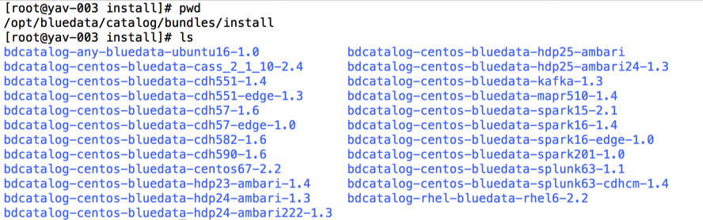
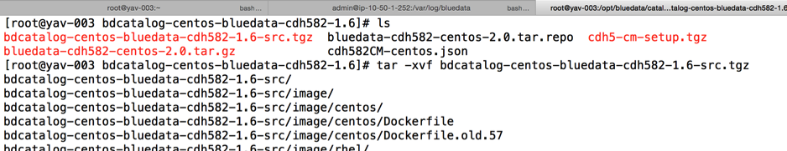
Step 1: Find existing CDH package and unpack file
ssh into BlueData controller host
Navigate to /opt/bluedata/catalog/bundles/install
Choose a specific CDH version (this example uses bdcatalog-centos-bluedata-cdh5102-1.6)
Open this bundle directory and untar the bdcatalog-…..1.6-src.tgz as shown below

Slide 73
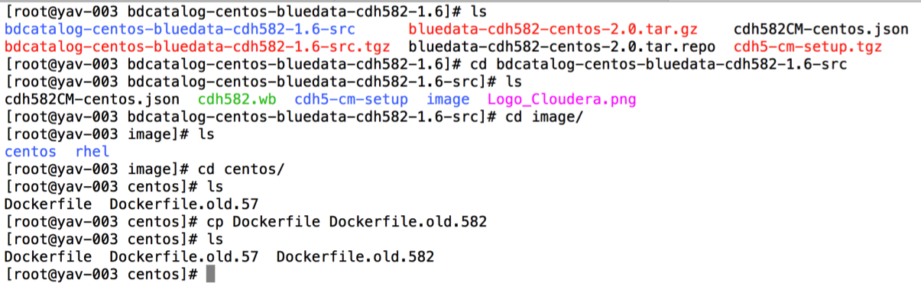
Step 2: Navigate to Docker file and update with CDH and CDH Manager software bits/parcels
Make a copy of the existing Dockerfile and rename
Edit the Dockerfile using your favorite editor

Slide 74
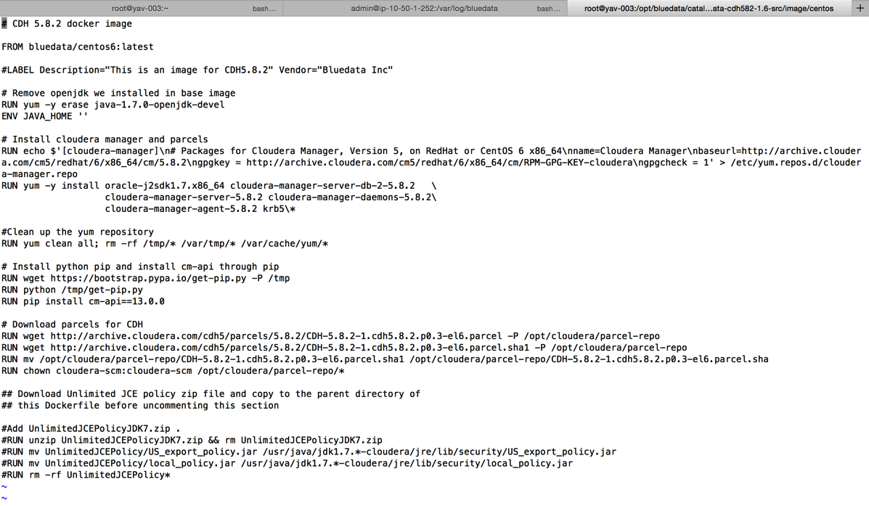
Step 2: Navigate to Docker file and update with CDH and CDH Manager software bits/parcels
View the existing Docker file
Prepare to update the metadata, cloudera manager & parcels, CM-API & CDH parcels

Slide 75
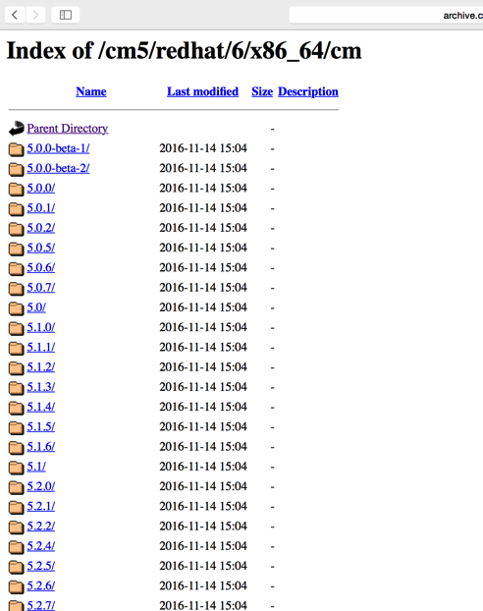
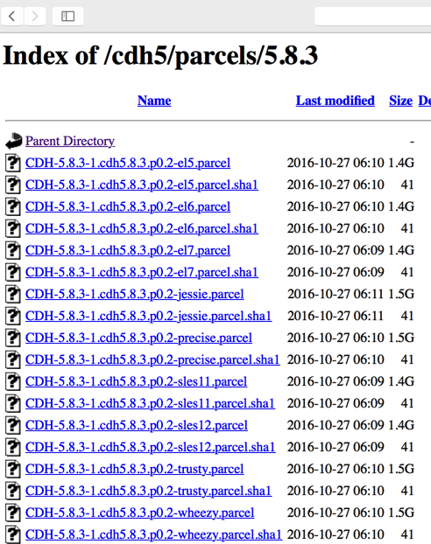
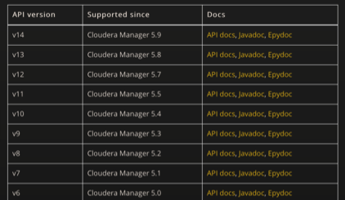
Step 2: Navigate to Docker file and update with CDH and CDH Manager software bits/parcels
CLOUDERA MANAGER PARCELS
CDH PARCELS
CM-API version
http://archive.cloudera.com/cm5/redhat/6/x86_64/cm/
http://archive.cloudera.com/cdh5/parcels/5.8.3/
http://cloudera.github.io/cm_api/docs/releases/

Slide 76

Step 2: Navigate to Docker file and update with CDH and CDH Manager software bits/parcels in cloudera-manager.repo

Slide 77

Step 2: Navigate to Docker file and update with CDH and CDH Manager software bits/parcels
Updated file with references to CDH 5.8.3

Slide 78


Step 3: Create new JSON file corresponding to image
NAVIGATE TO THE TOP LEVEL DIRECTORY AS SHOWN BELOW
Make a copy of the existing JSON file (e.g. cdh582CM-centos.json to cdh583CM-centos.json)
Edit the JSON file as shown above
NOTE: Define a new distroID to keep both images simultaneously in the App Store

Slide 79

Step 3: Edit JSON file to specify the correct parcels (based on Dockerfile)
In the config section, make sure to specify the link to the parcel directory, full version and the parcel version.
This is used in the startup script for data driven configuration of the CDH cluster

Slide 80

Step 4: Create new .wb file (update reference to JSON file & builder organization)
NAVIGATE TO THE TOP LEVEL DIRECTORY AS SHOWN BELOW
Make a copy of the existing .wb file (e.g. cdh582.wb to cdh 583.wb)
Edit .wb file to add reference to the previously created JSON file

Slide 81

Step 5: Build .wb file
Build the wb file.
Wait for 30 min
.bin file will be generated.
Copy the bin file to /srv/bluedata/catalog
Click Refresh on BlueData App Store UI

Slide 82

Comprehensive upgrade script for CDH5.x upgrades
Extract cdh5xy.tgz
Replace the values as shown below
Rerun upgrade script
New bin will be available under deliverables
Example values in upgrade script
sed -i 's/@@@@CDH_VERSION@@@@/5.8.2/g' image/centos/Dockerfile cdh5-meta-centos.json
sed -i 's/@@@@CDH_PARCEL_NBR@@@@/5.8.2-1.cdh5.8.2.p0.3/g' image/centos/Dockerfile cdh5-meta-centos.json
sed -i 's/@@@@PARCEL_PREFIX@@@@/e16/g' image/centos/Dockerfile cdh5-meta-centos.json
sed -i 's/@@@@DISTRO_ID@@@@/cdh582/g' image/centos/Dockerfile cdh5-meta-centos.json
sed -i 's/@@@@CM_API_VERSION@@@@/12.0.0/g' image/centos/Dockerfile cdh5-meta-centos.json

Slide 83


BlueData App Store (before & after)

Slide 84

How to add new services to the existing CDH image?
Update dockerfile with new service bits or dependency install bits.
For ex: In order to install python 3.6, update dockerfile with the following code below.

Slide 85

How to add new services to the existing CDH image?
To add Spark service to existing CDH image then update the following code in your dockerfile.

Slide 86


How to add new services to the existing CDH image?
Update JSON with services. For ex: Spark

Slide 87


How to add new services to the existing CDH image?

Slide 88

How to add new services to the existing CDH image?
Update setup_cluster.py with custom services
Update spark configuration code

Slide 89
Summary
After the session user should be familiar with,
BlueData AppStore concepts
Adding/removing bin files
Generating, modifying, exploring bin files
Adding multiple
Understanding of manually generating cluster metadata/deployment json
Building a new application in AppStore using existing files

Slide 90


Slide 91
ActionScripts
What are ActionScripts?
Capability to run ad hoc commands/scripts on compute nodes post to cluster creation.
Authorized users can run ActionScripts.
ActionScripts can be a shell, Java, python and other language script.
Actions can be submitted as a
CLI commands from the WebUI or
Uploading a script with set of commands or
Submit a REST API with a JSON payload.

Slide 92
Use cases of ActionScripts
ActionScript use cases can be several. Some specific ones include:
Ability to run bash commands on one or many nodes of a cluster, in parallel. Example:
yum -y install <python_package>
mkdir /usr/lib/<dir_name>
Ability to view common log files on all nodes of a cluster
tail -f /var/log/bluedata/guestconfig.log
Execute commands on a specific node of the cluster instead of all nodes
Ability to submit hadoop, spark, python/R jobs from Bluedata UI
View the output of the commands from WebUI
Invoke commands using REST API
Sample action scripts are available at this git repository
https://github.com/bluedatainc/solutions/tree/master/ActionScripts/scripts

Slide 93
Run model through Jupyter notebook
Notes:
For ex: Typically user runs models through notebooks like Jupyter/Zeppelin.

Slide 94

Run a model through Spark-submit in CLI
Notes:
Another option is to run models is through CLI using Spark-Submit or Spark-shell

Slide 95

Run a model through ActionScript
Notes:
You can do the above similar actions using ActionScript and doesn’t have to login or ssh to cluster nodes and go through the pain. Post to cluster creation, there is an ActionScript tab to perform any actions on one or more cluster containers.

Slide 96

Run a model through ActionScript

Slide 97

Run a model through Action Script

Slide 98

Run a model through Action Script

Slide 99

Run a model through Action Script

Slide 100
Sample ActionScripts in github
https://github.com/bluedatainc/solutions/tree/master/ActionScripts/scripts

Slide 102
Agenda – Day 3
Topics | Content | Owner | Time
APIs | Introduction to APIs Types of BlueData APIs | Sahithi | 9:00 am -10:15 am
Break |  |  | 10:15 am – 10:30 am
APIs | Walkthrough all the github APIs Lab exercise to create cluster, create tenant etc., | Sahithi | 10:30 am – 11:30 am
BlueData Monitoring concepts | High-level workflow of Monitoring in EPIC Elastic Search Monitoring concepts | Sahithi | 11:30 am –12:30 pm
Lunch |  |  | 12:30 pm – 1:30 pm
BlueData Alerting concepts | Alerting concepts in EPIC Set up email alerts using Nagios | Sahithi | 1:30pm – 2:30pm
Q&A | Any specific usecase questions |  | 2:30pm – 4:00pm

Slide 103


Slide 104

What is REST API??
Notes:
To make it simple,
REST API defines a set of functions to which the developer can perform requests and receive responses.
The interaction is performed via the HTTP or HTTPS protocol.

Slide 105
BlueData Restful API
All actions that’s performed in UI can be submitted as REST APIs. These are generally classified under
Tenant Actions (CRUD, list Tenants)
Tenant configuration APIs (Nodes, IP addresses, roles, users)
Cluster life cycle APIs (List clusters, start, stop, reboot)
Cluster configuration APIs (Nodes, IP addresses, roles, services)
ActionScripts (Add packages, submit jobs, add users)
DataTap Actions (CRUD)
APIs use the same authentication as BlueData UI and can be accessed over https

Slide 106

Site Admin & Tenant APIs
Tenant APIs
Login & session creation
Obtain Tenant Admin session
Install catalog image
Create a Hadoop cluster
Manage life-cycle of virtual cluster (start/stop/delete/reboot/etc.)
List all virtual nodes
Create a new DataTap (storage access)
Invoke ActionScript
Invoke Bootstrap script
Submit a job to a cluster & more.
Site Admin APIs
Login & session creation
Create new tenants
Assign security role to tenant
Reset password
Get users for tenant
Revoke user access to tenant & more
Notes:
Basically, anything you can do via UI can be done through REST APIs.

Slide 107


Login & session header API
Notes:
In order to invoke any BlueData specific APIs, we need to get a session ID from Login API. In the sample response, the value provided in the Location field is your session ID, e.g. /api/v1/session/ad93b4bb-8908-4af9-8c36-ea4f92f29277. You will use this session ID for any API calls you make during the session.

Slide 108

Switch to a tenant
Notes:
In order to fetch any information in a specific tenant, you need to invoke this API and then you will be able to get all the information related to a specific tenant resources, clusters and Kerberos settings.

Slide 109

Get all tenants
Notes:
Provides list of all the tenants in a specific epic deployment.

Slide 110

Get a specific tenant & configs
Notes:
This is the most commonly used API for fetching all the resources that has been allocated to a specific tenant. This helps a lot to understand how many resources are in use vs. are in free state.

Slide 111

Get all cluster images
Notes:
Provides list of all clusters in a specific tenant.

Slide 112

Get virtual cluster resource info
Notes:
Provides all the information related to cluster resources.

Slide 113

Retrieve Epic platform configuration
Notes:
This API provides the information related to the Epic platform configuration. For ex: AD or LDAP configured or tenant_types.

Slide 114
Our API doc and references.
Github location:
https://github.com/bluedatainc/solutions/blob/master/APIs/bluedata_apis_doc.md
Zendesk location:
https://bluedata.zendesk.com/hc/en-us/categories/115000237354-RESTful-API-Action-Scripts

Slide 115
V2 API doc reference
Access this link to find BlueData v2 API docs.
http://<controller-IP>:8080/apidocs/
Some v2 APIs are updated in Solutions github repo. https://github.com/bluedatainc/solutions/blob/master/APIs/v2_bluedata_apis_doc.md

Slide 116


Slide 117
Monitoring or Alerting mechanism
EPIC Platform
Virtual Cluster environment

Slide 118
Epic Platform Monitoring
For real-time monitoring service information standard Linux commands or scripts should work.
For ex: Top, VmStat, Lsof, Monit etc.,
https://www.tecmint.com/command-line-tools-to-monitor-linux-performance/

Slide 119


Epic Platform Alerting
All the Epic registered services are tracked through Nagios. In order to access Nagios, here are the details:
Nagios URL: http://<controller_ip>:8085/nagios
The default login/password for Nagios on BlueData is username: nagiosadmin; password: nagiosadmin

Slide 120

Epic Platform Alerting
All these services under the Epic service tab are highly critical which can bring the Epic down except Monitoring service.

Slide 121
Setup email Alerts in Nagios
Links for setting up email alerts in Nagios:
https://access.redhat.com/documentation/en-us/red_hat_gluster_storage/3/html/console_administration_guide/configuring_nagios_to_send_mail_notifications
Sample doc in setting up Nagios alerts:
https://docs.google.com/document/d/1c93-t6xZfm-6sZL0PfBDTlM_yDVhfd83UqAkB-2V_XA/edit

Slide 122

Virtual cluster monitoring
1. All the BlueData dashboard metrics are dynamically updated by Elastic search.
2. Elastic search can be accessed through Kibana dashboard provided which is part of Epic platform.
3. BlueData provides two python scripts each with a specific purpose depending on the type of data to download
bdcsv.py
bdusage.py

Slide 123
Virtual cluster monitoring
bdcsv.py:
What does the script do?
This extracts raw CPU, memory, network and disk usage for each virtual node in the tenant managed by specified credentials, or all tenants if the Site Admin user and password are specified.
Where is the script located in BlueData environment?
/opt/bluedata/bundles/<bundlename>/scripts/monitoring/
How to run the script?
python bdcsv.py –c <Controller-IP> -f <credentials-file> -s <start-time> -e <end-time>
where
<Controller-IP> Bluedata Epic controller IP
<credentials-file> it’s a JSON file with username and password
for ex: credential_file.json:
{
“user”: <username>,
“password”: <password>
}

Slide 124

Virtual cluster monitoring
<start-time> Specific day-time stamp YYYY/MM/DD-HH:MM:SS
for ex: 2018/04/29-16:32:20
<end-time> Specific day-time stamp YYYY/MM/DD-HH:MM:SS
for ex: 2018/04/29-16:32:20
Additional options are available when you run this command,
python bdcsv.py

Slide 125

Virtual cluster monitoring

Slide 126
Virtual cluster monitoring
bdusage.py:
What does the script do?
This extracts the number of hours in the given data each virtual node was powdered on, potentially useful for billing tenant users.
A virtual node is considered to be in use during an hour if it was powered on at any time in that hourly interval.
Where is the script located in BlueData environment?
/opt/bluedata/bundles/<bundlename>/scripts/monitoring/
How to run the script?
python bdusage.py –c <Controller-IP> -f <credentials-file> -s <start-time> -e <end-time> -o <output-file>
where
<Controller-IP> Bluedata Epic controller IP
<credentials-file> it’s a JSON file with username and password
for ex: credential_file.json:
{
“user”: <username>,
“password”: <password>
}

Slide 127

Virtual cluster monitoring
<start-time> Specific day-time stamp YYYY/MM/DD-HH:MM:SS
for ex: 2018/04/29-16:32:20
<end-time> Specific day-time stamp YYYY/MM/DD-HH:MM:SS
for ex: 2018/04/29-16:32:20
Additional options are available when you run this command,
python bdusage.py
Notes:
Will share the exact monitoring docs with Citi

Slide 128

Virtual cluster monitoring
Notes:
The last column provides # of hours used on that container. Typically it is used for billing cycles.

Slide 129

Virtual cluster alerting
All the services under virtual cluster “service status” tab are registered through Image JSON and hence BlueData tracks these services.

Slide 130

Virtual cluster alerting
There is an API to get Virtual cluster service status, Cluster_service_status
Notes:
You can integrate this API to any service alert scripts to report alerts for BlueData cluster services.
https://github.com/bluedatainc/solutions/blob/master/APIs/v1_bluedata_apis_doc.md#42-get-cluster-service-status

